Slide 1
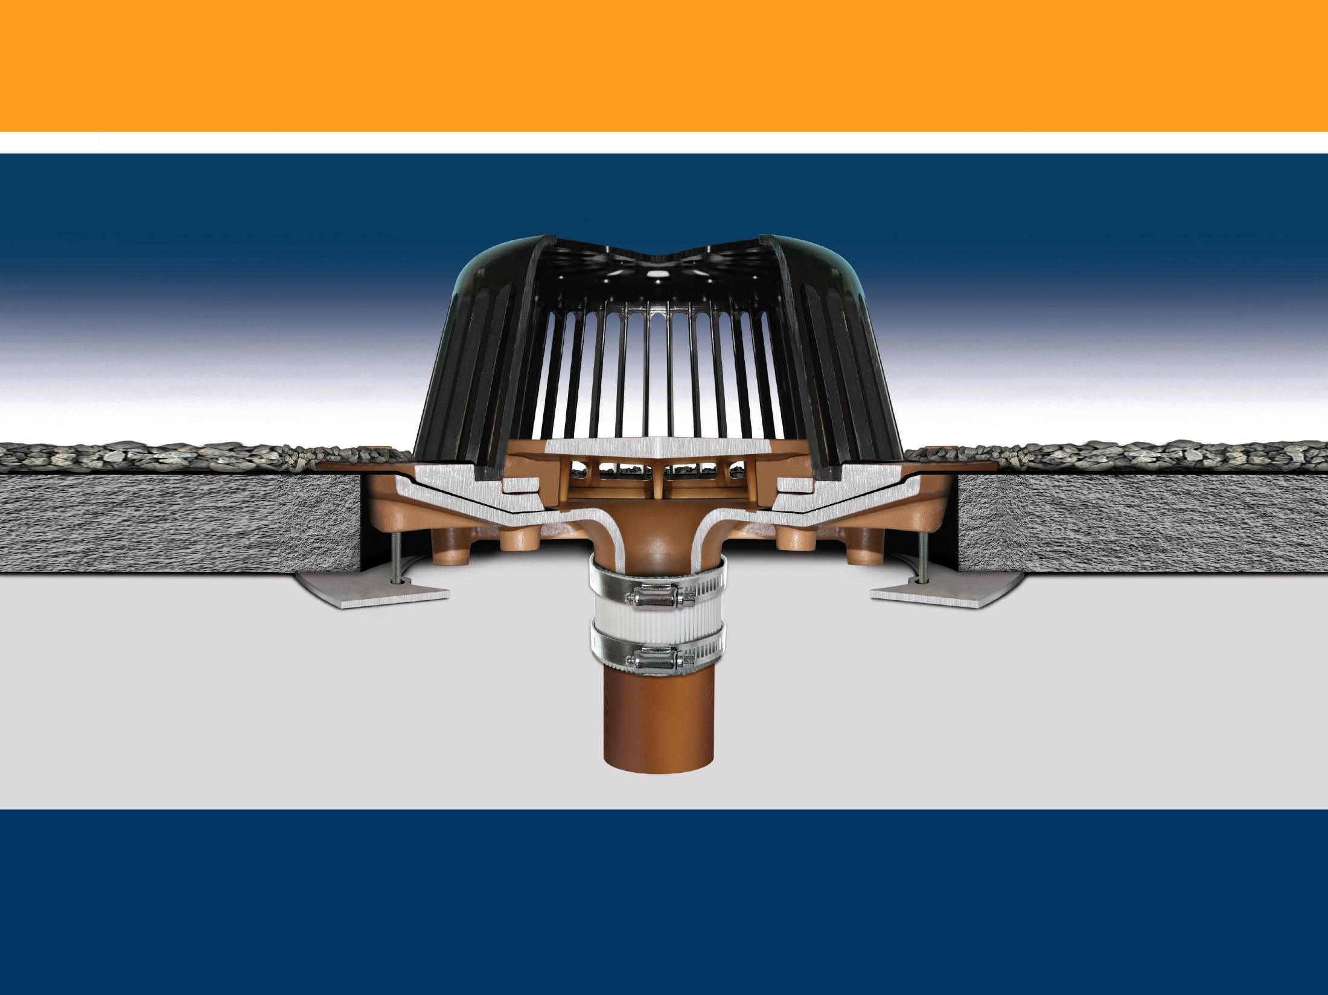
Siphonic Roof Drains
The level approach to roof drainage

Slide 2
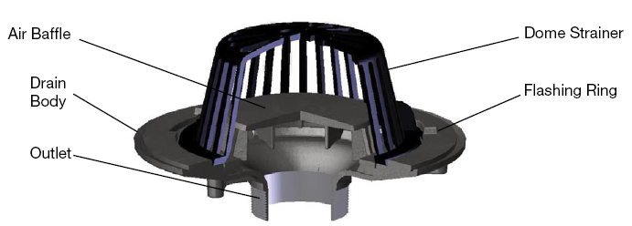
Introduction/ Brief Summary
Siphonic Roof Drainage – A Short History
- First siphonic drain Invented and patented in 1968, the concept was primarily used in Scandinavia during the 1970s and later in Europe and the rest of the world.
- First major installation was at a turbine factory in Sweden in 1972.
- First U.S. building using siphonic drainage - Boston Convention Center, 1999.
- Major interest in the US began with article in PM Engineering Magazine “Siphonic Roof Drainage Fundamentals,” by John Rattenbury P.E. in 2001.
- IKEA Home Furnishings imports technology into the U.S. starting in 2002.
Jay R. Smith Mfg. Co. developed and started marketing the first U.S. made siphonic roof drain, 2006.
Siphonic Roof Drain Anatomy – What is a siphonic roof drain?
- Looks much like a traditional roof drain.
- The distinguishing feature is the air baffle.
- The air baffle is engineered and tested to prevent air from entering the piping system at peak flows.
1

Slide 3
Siphonic Roof Drain Sales Opportunity
Benefits to the owner, engineer and contractor
Reduced building costs – less material, fewer vertical stacks, less excavation, backfill, ground work and exterior underground piping.
Design flexibility – level pipe installation, stack and horizontal pipe location are highly flexible simplifying coordination with other building elements.
Save money in time, material and site preparation – smaller pipe sizes, minimized installation costs.
Innovative and efficient roof drainage solution especially for low rise buildings with large footprints and flat roofs.
Product looks like and installs like a traditional roof drain Is not proprietary like European products.
Product uses existing and familiar accessories and allows use of existing pipe, fitting and coupling products (no specialized pipe).
New construction or retrofit potential (easy replacement of drainage piping).
2

Slide 4
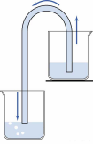
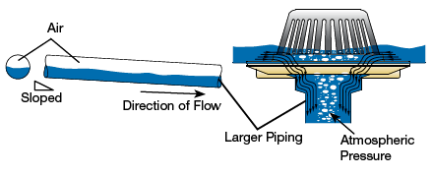
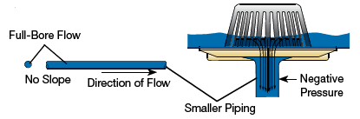
Main Principles of Siphonic Roof Drains
The Siphon Principle
- A well understood hydraulic principle with many useful applications.
- Discharge end is lower than the level of fluid in the reservoir.
- A continuous and closed drainage path induces flow by gravity.
- Atmospheric pressure becomes the driving force pushing the fluid through the tube to the lower point of discharge
- Path of siphon tube is irrelevant to the fluid’s ability to flow, i.e. could be flat and level
Traditional roof drainage
Siphonic roof drainage
Open outlets allow water and air to enter,
Pitched horizontal piping induces flow,
Atmospheric pressure throughout the system,
Capacity is limited by drain size and water depth,
Piping is only ½ to 2/3 full.
“Closed” outlets – air baffle promotes “full-bore” flow,
Horizontal piping is not pitched,
Atmospheric pressure pushes water into the system,
Capacity is determined by piping and elevation difference,
Piping primes and operates 100% full.
3

Slide 5
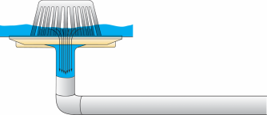
Benefits of Siphonic Drainage
Why you should consider a siphonic roof drain system:
Reduced material costs - smaller pipe diameters means less $,
Reduced underslab work and building costs - level pipe installation overhead with fewer vertical stacks,
Pipe locations are highly flexible (horizontal and stack),
Higher flow velocity - driving head up to 100 times that of traditional system,
Reduced exterior excavation, backfill and underground piping and structures,
Opportunity to economically enable rainwater harvesting.
4

Slide 6
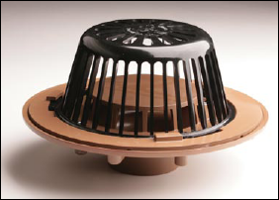
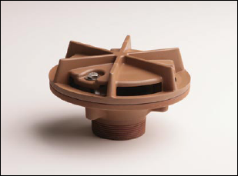
Siphonic Roof Drain Models
Fig. No. 1005 (15 ¼” diameter)
Function: For use in engineered siphonic roof drainage systems in flat roof of any construction. Internal air baffle creates siphonic drainage action producing a more efficient drainage than conventional roof drains.
Regularly Furnished: Duco Cast Iron Body, Flashing Clamp, Air Baffle and Polyethylene Dome.
Available with No-Hub Outlet
Outlet Sizes: 2”, 3” and 4”
Fig. No. 1605 (6” diameter)
Function: For use in engineered siphonic roof drainage systems for gutters, parapets, small balconies, sills, cornices, marquees and other small overhanging areas where drainage of rainwater is required. Air baffle creates siphonic drainage action producing a more efficient drainage than conventional gutter drains.
Regularly Furnished: Duco Cast Iron Body with Combination Flashing Clamp and Air Baffle.
Available with No-Hub Outlet
Outlet Size: 2”
5

Slide 7
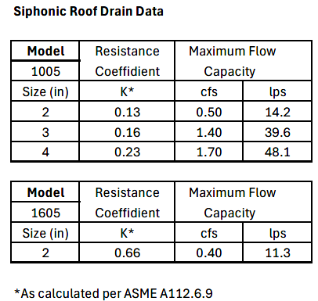
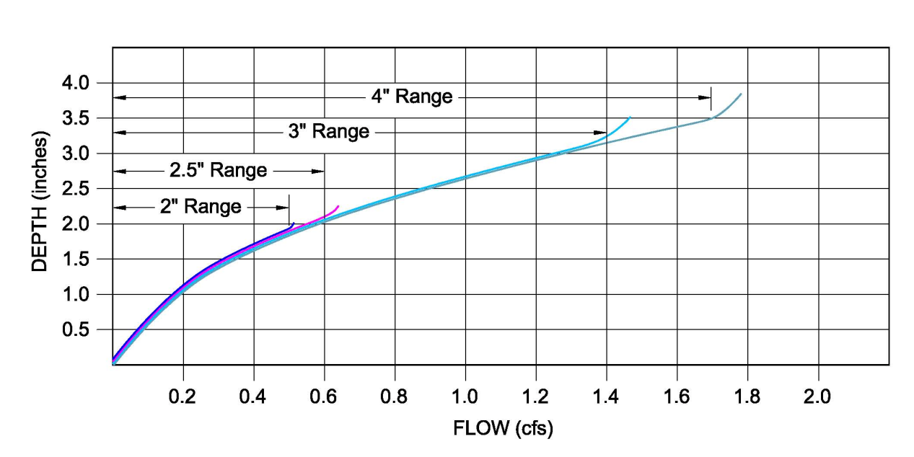
Siphonic Roof Drain Models
Siphonic Roof Drain
Product data is provided to the specifier for outlet size selection and hydraulic calculations.
Sizing is a function of the roof runoff factor, design rainfall intensity and the area draining to the roof drain.
6

Slide 8
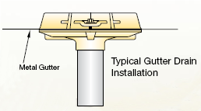
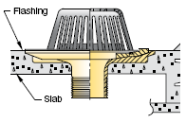
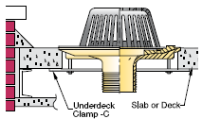
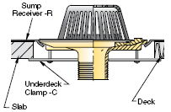
Installation
Fig. No. 1005, Low Profile Dome
Fig. No. 1605 Low Profile Gutter Drain
Poured Concrete
Drain set in poured roof deck slab. Flashing is secured by a non-puncturing flashing clamp.
Precast Deck
Drain with underdeck clamp -C used where roof drain openings are pre-sleeved or sawed-out in the slab. May be used in any slab or deck. NOTE: Drain flange rests in a recessed portion of the deck, eliminating sump receiver.
Gutter drain set in poured roof deck slab. Flashing is secured by a non-puncturing flashing clamp.
Product design uses all existing installation accessories. Standard installation procedures apply.
Insulated Deck
Drain with sump receiver -R and underdeck clamp -C. The sump receiver is a square metal plate that accepts the drain body flange and eliminates the puddle of water surrounding the drain.
7

Slide 9

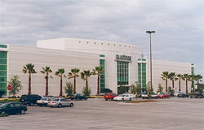
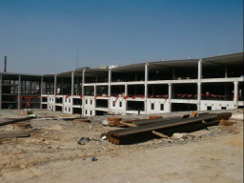
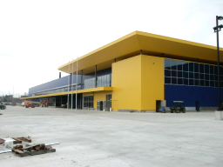
Applications
Siphonic systems are especially ideal for low rise buildings with large footprints and flat roofs such as:
Data Centers
Airport Terminals
Convention Centers
Aircraft Hangers
Warehouses
Covered malls
Data Centers
Factories
Train Stations
Office Complexes
Retail
Distribution Centers
8

Slide 10

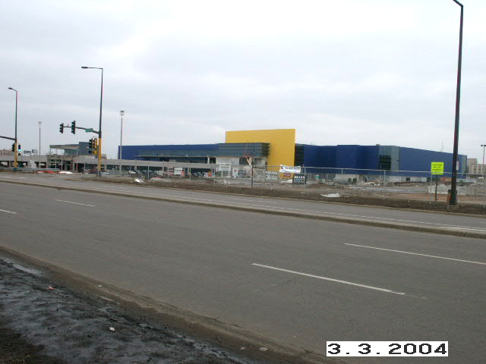
Case Studies
Siphonic systems customers include institutional, commercial and retail facilities.
Boston Convention Center, Boston, MA IKEA Home Furnishings, Stoughton,MA
IKEA Home Furnishings, Bloomington, MN IKEA Home Furnishings, Atlanta, GA
10

Slide 11
Case Studies
Boston Convention and Exhibition Center, South Boston, MA
Traditional Gravity System
Siphonic Solution
11

Slide 12
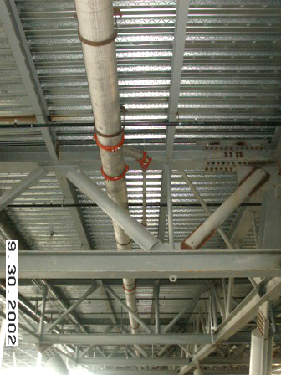
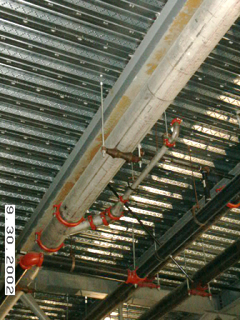
Case Studies
Boston Convention and Exhibition Center, South Boston, MA
12

Slide 13
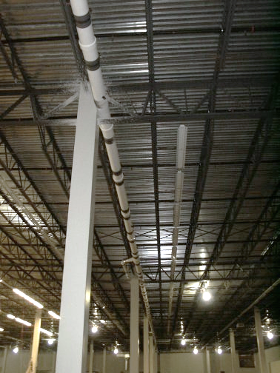
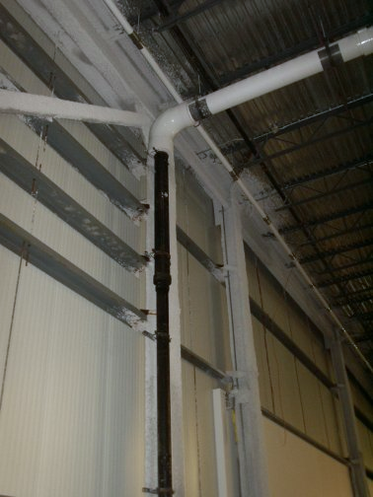
Case Studies
IKEA Home Furnishings, Stoughton, MA
14

Slide 14
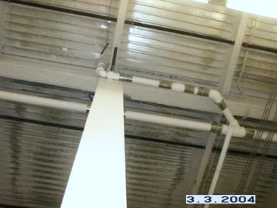
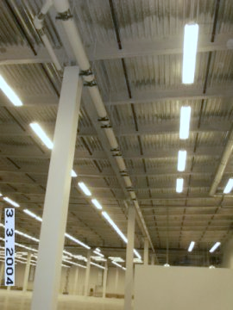
Case Studies
IKEA Home Furnishings, Bloomington, MN
Siphonic Piping Overhead in Merchandise
Warehouse: Maximum Clear Height
16

Slide 15
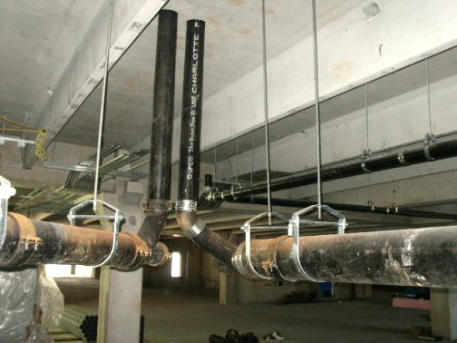
Case Studies
IKEA Home Furnishings, Atlanta, GA
18

Slide 16
Siphonic Roof Drains – Codes and Standards
ANSI/ASME A112.6.9 “Siphonic Roof Drains” Performance Standard
ASPE Tech Standard 45 “Siphonic Roof Drainage”
International Plumbing Code (IPC) – Includes Siphonic Drainage as part of the code (Section 1107) in accordance with ASME A112.6.9 Standard and ASPE Tech 45 Standard.
Uniform Plumbing Code (UPC) - – Includes Siphonic Drainage as part of the code (Section 1106) in accordance with ASME A112.6.9 Standard and ASPE Tech 45 Standard.
IAPMO listed – file 5138
To date, no code body has rejected Siphonic Design as Engineered System when demonstrated by Plumbing Engineer to be equal to conventional system.

Slide 17

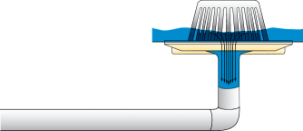
Engineering Resources
ASPE TECH STANDARD 45 Plumbing Engineering & Design Standard “Siphonic Roof Drainage” is available on the ASPE website.
ASME A112.6.9 Performance Standard for Siphonic Roof Drains is available on ASME website.
www.PDHonline.org Course M256 “Siphonic Roof Drainage” Course in Siphonic Roof Drainage Design
SIPHONIC DESIGN SOFTWARE available to simplify design, assure consistency and enhance accuracy of the results.
VARIOUS LITERATURE AND INSTRUCTURAL MATERIAL such as
Brochures, Submittals, Sample Specifications, Presentation, Case Studies and
Videos are also available at www.jrsmith.com

Slide 18
Engineering Resources
GENERAL INFORMATION: Siphonic systems are generally
recommended for low rise buildings with large foot prints
with 50,000 or more total square footage.
Placing the siphonic drains in a gutter works best.
Small roof areas and/or high rise buildings are difficult to design and balance.
You will need to know the square footage of roof area assigned to each roof drain and the design rainfall rate (inches per hour).
This along with other basic information such as piping material, job information and location (zip code) are also required

Slide 19
Engineering Resources
In using the Design Software to design a Siphonic Roof
Drainage System, each and every piping element of the drainage system has to be accounted for in the software calculations.
Therefore, you must know the dimensions of the complete
piping system.
ROOF DETAIL: Engineer will need to produce a detailed drawing (with dimensions) of the roof with drain locations and how the water is directed to the drains.
PIPING SYSTEM DETAILS/LAYOUT: An isometric or 2D drawing must be created and for the whole piping system from each roof drain to the discharge point (where the siphon is terminated and converts to large sloped piping sized per code approved piping flow charts).

Slide 20
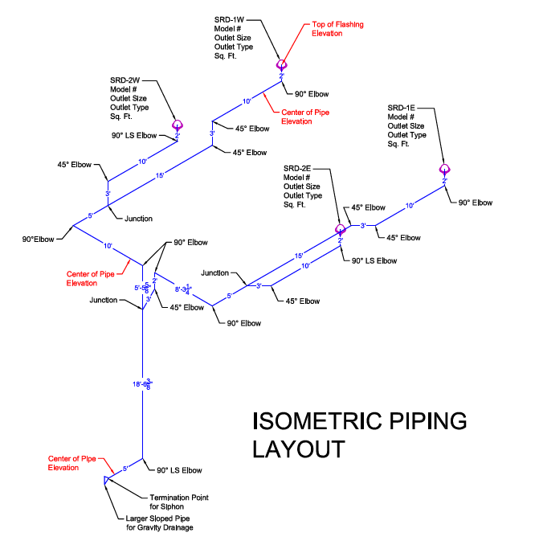

Slide 21
Engineering Resources
EMERGENCY OVERFLOW: Determine how the emergency overflow drains will be incorporated into the design.
Scupper drains through the parapet are preferred.
Otherwise, determine if the overflow drains and piping will be conventional or siphonic (siphonic overflow system is not recommended for divided/cricket roof systems – contact Smith’s Sales Engineering Department for more information).

Slide 22
Engineering Resources
If the engineer is not comfortable with designing a siphonic system, we have qualified licensed Plumbing Engineers/ Consultants that we can have design and stamp the system for them. However, you will still need to provide the information stated on the previous slides. An estimated completion date can be issued once the required information is provided and reviewed.
Keep in mind that when a system is designed using Jay R. Smith siphonic roof drains, Smith drains must be installed or the system will need to be redesigned using the alternate drain. Alternate Drains cannot just be substituted as they will change the dynamics and flow of the system.

Slide 23

Engineering Resources
Contractors and engineers will typically seek out available products to apply siphonic roof drainage on their projects.
“Selling the Concept” is primarily an RMS effort. We have started this effort and will continue to do so.
Inquiries by your customers about engineering/design should be referred to RMS for more information. Inquiries by our clients about product availability will be referred to Jay R. Smith or local representatives.
RMS has developed a software package to simplify design, assure consistency and enhance accuracy of the results.
Initial design services would be by RMS to assure quality and accuracy.
Other engineers will be trained by RMS to design systems and use the software.
This approach differs significantly from the current competition. They intend to keep design in house thereby depriving engineers and contractors of limited budget. Clients will resist this and favor the Smith/RMS approach.
We support open specification and in-house
capability, not proprietary outsourcing methods.
21

Slide 24
It’s Been Done. It Works. It Saves Money.
Siphonic Roof Drains
The level approach to roof drainage

