Slide 1
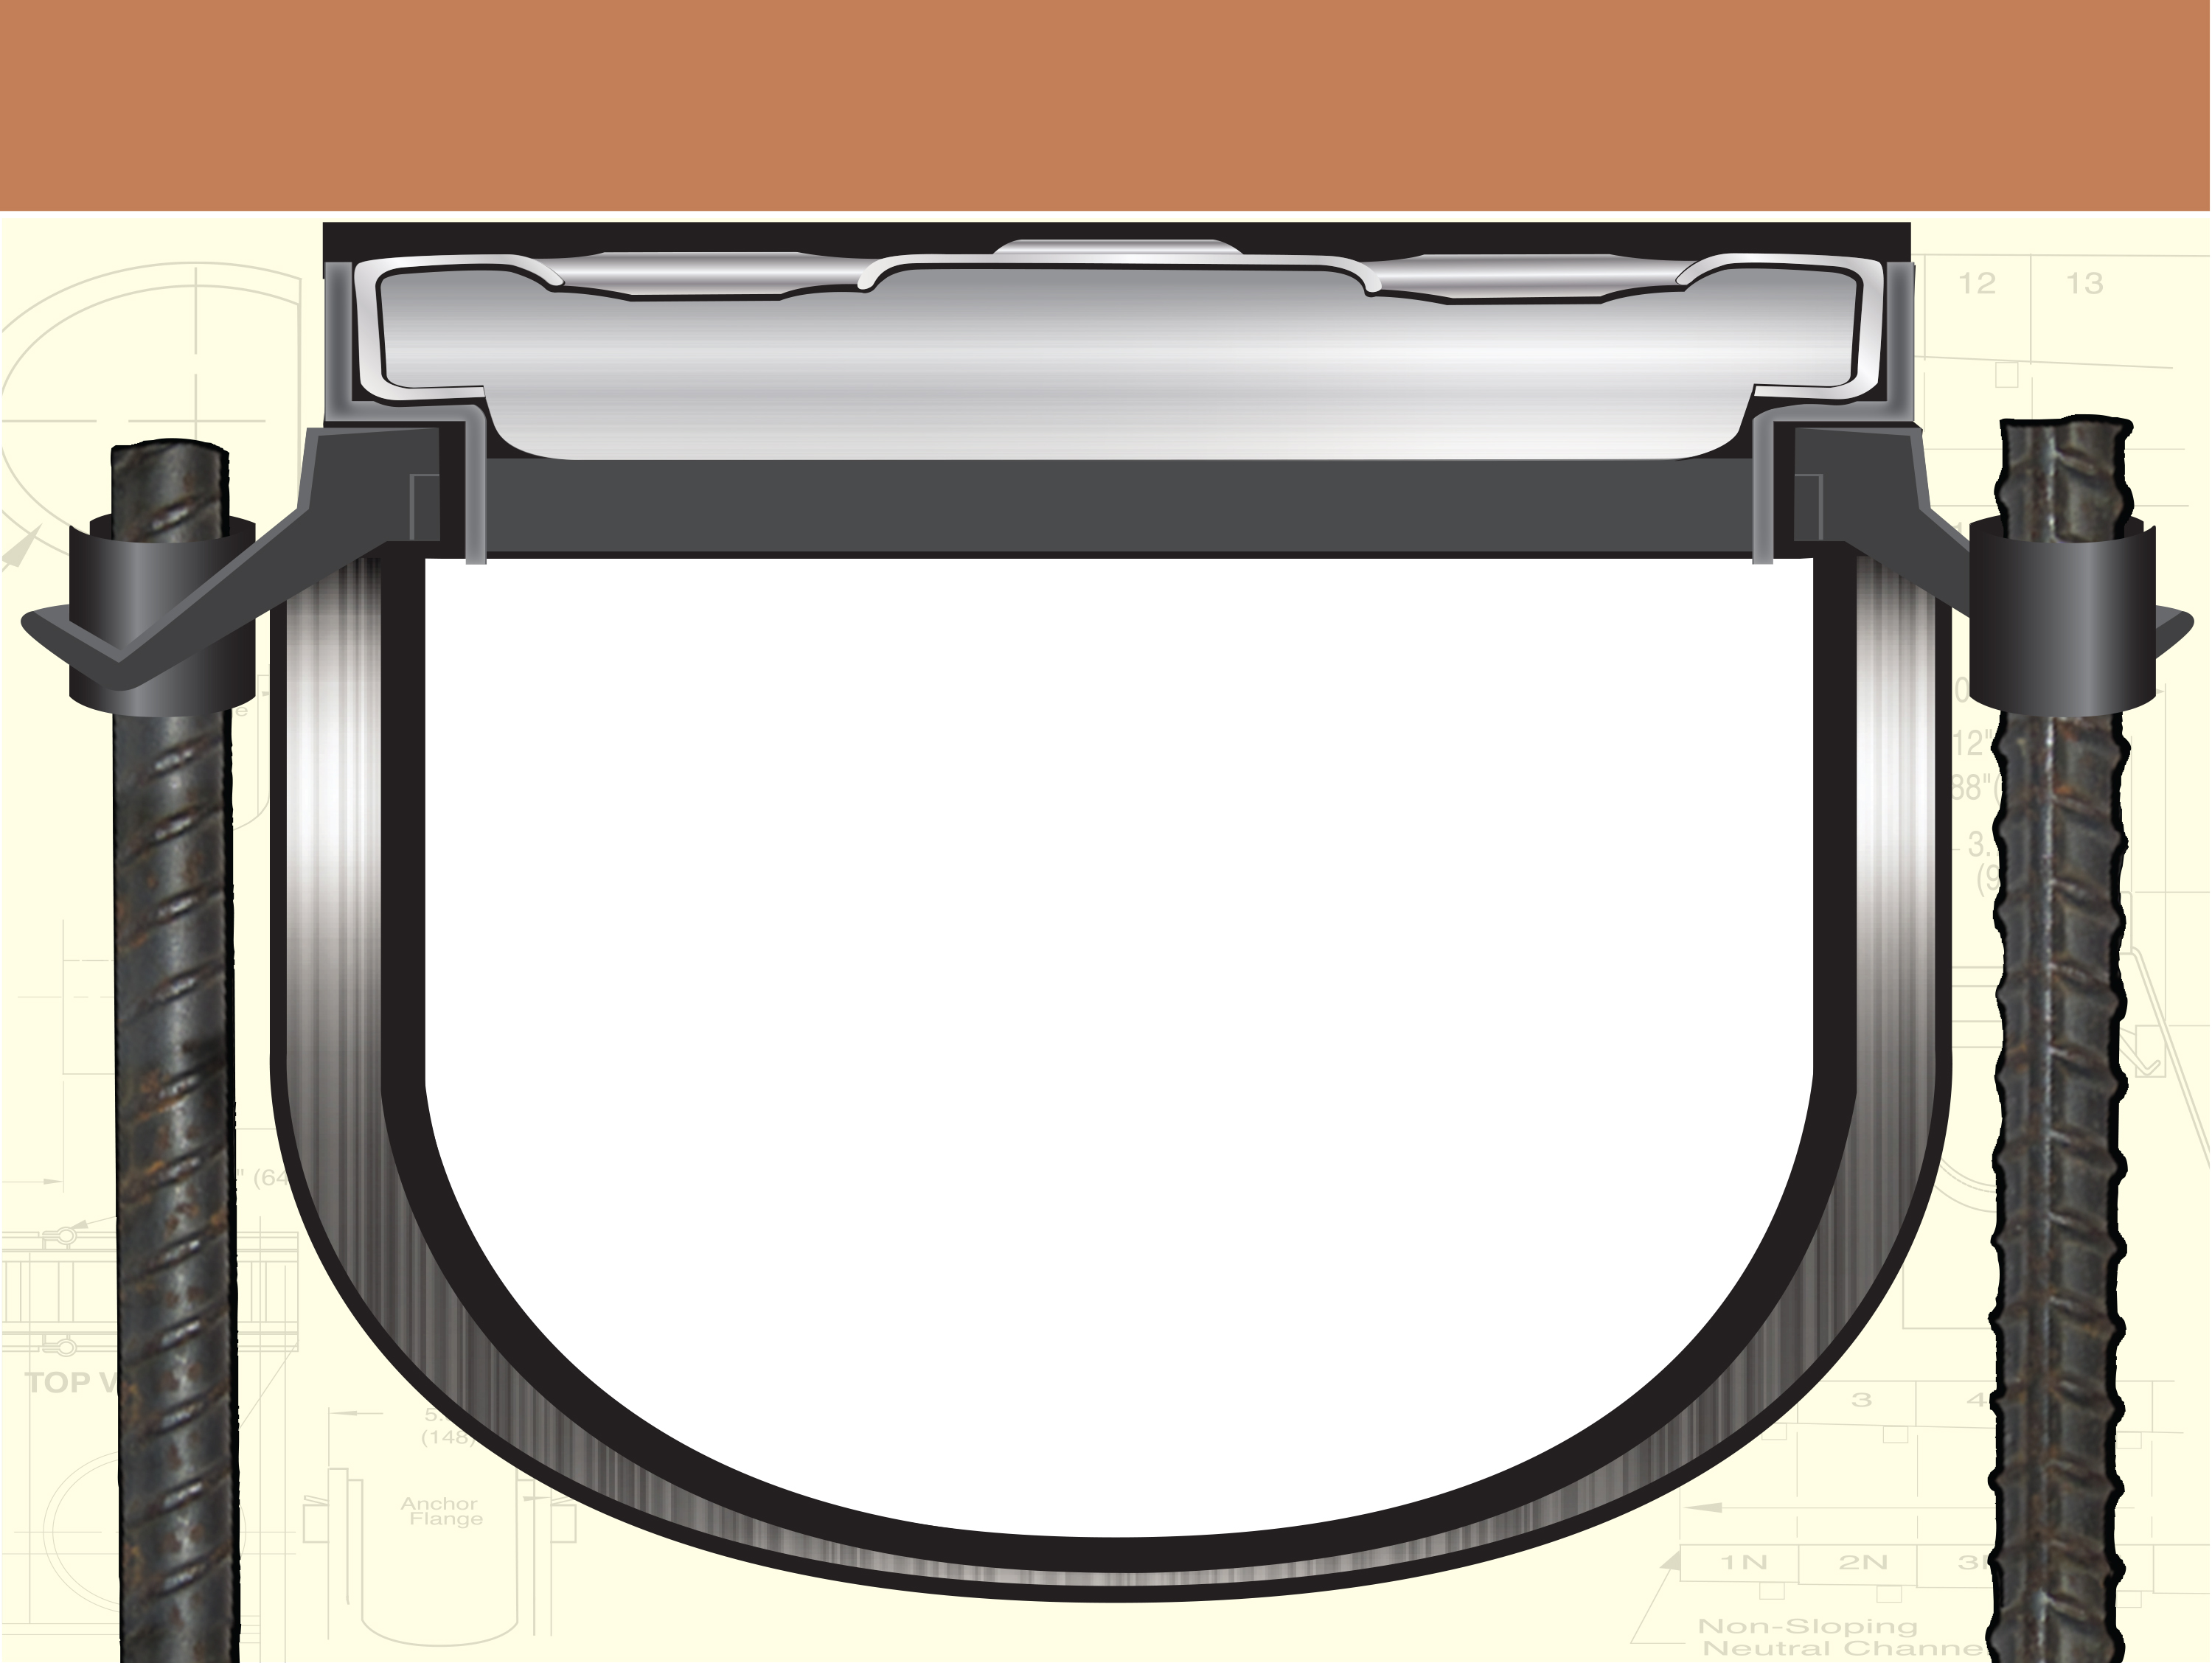
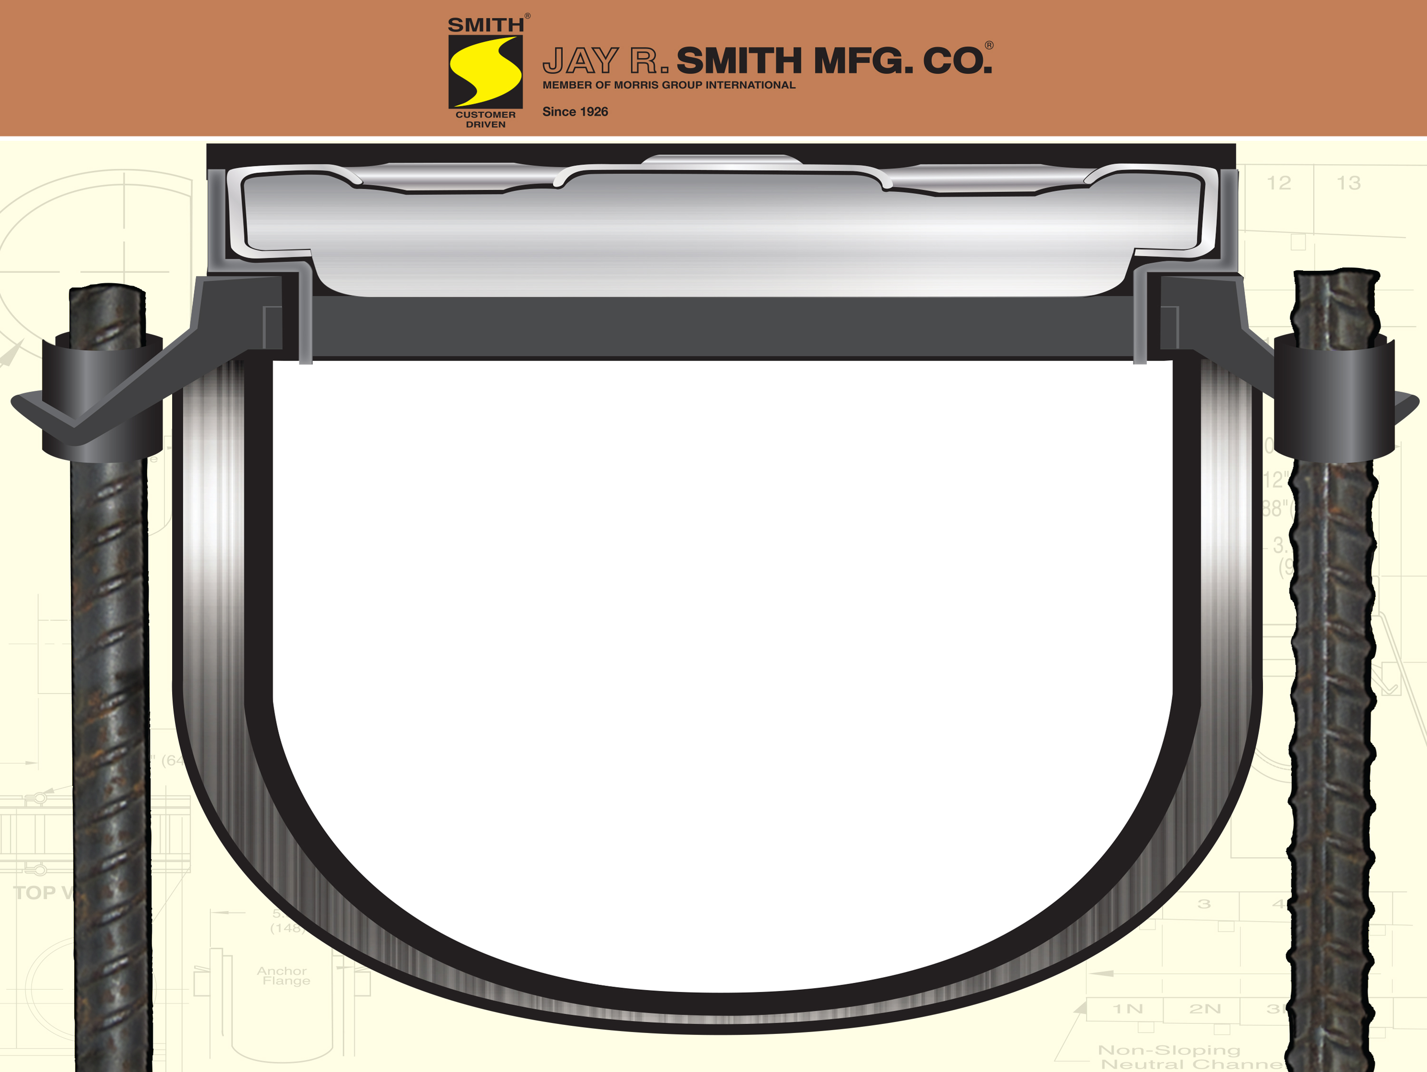
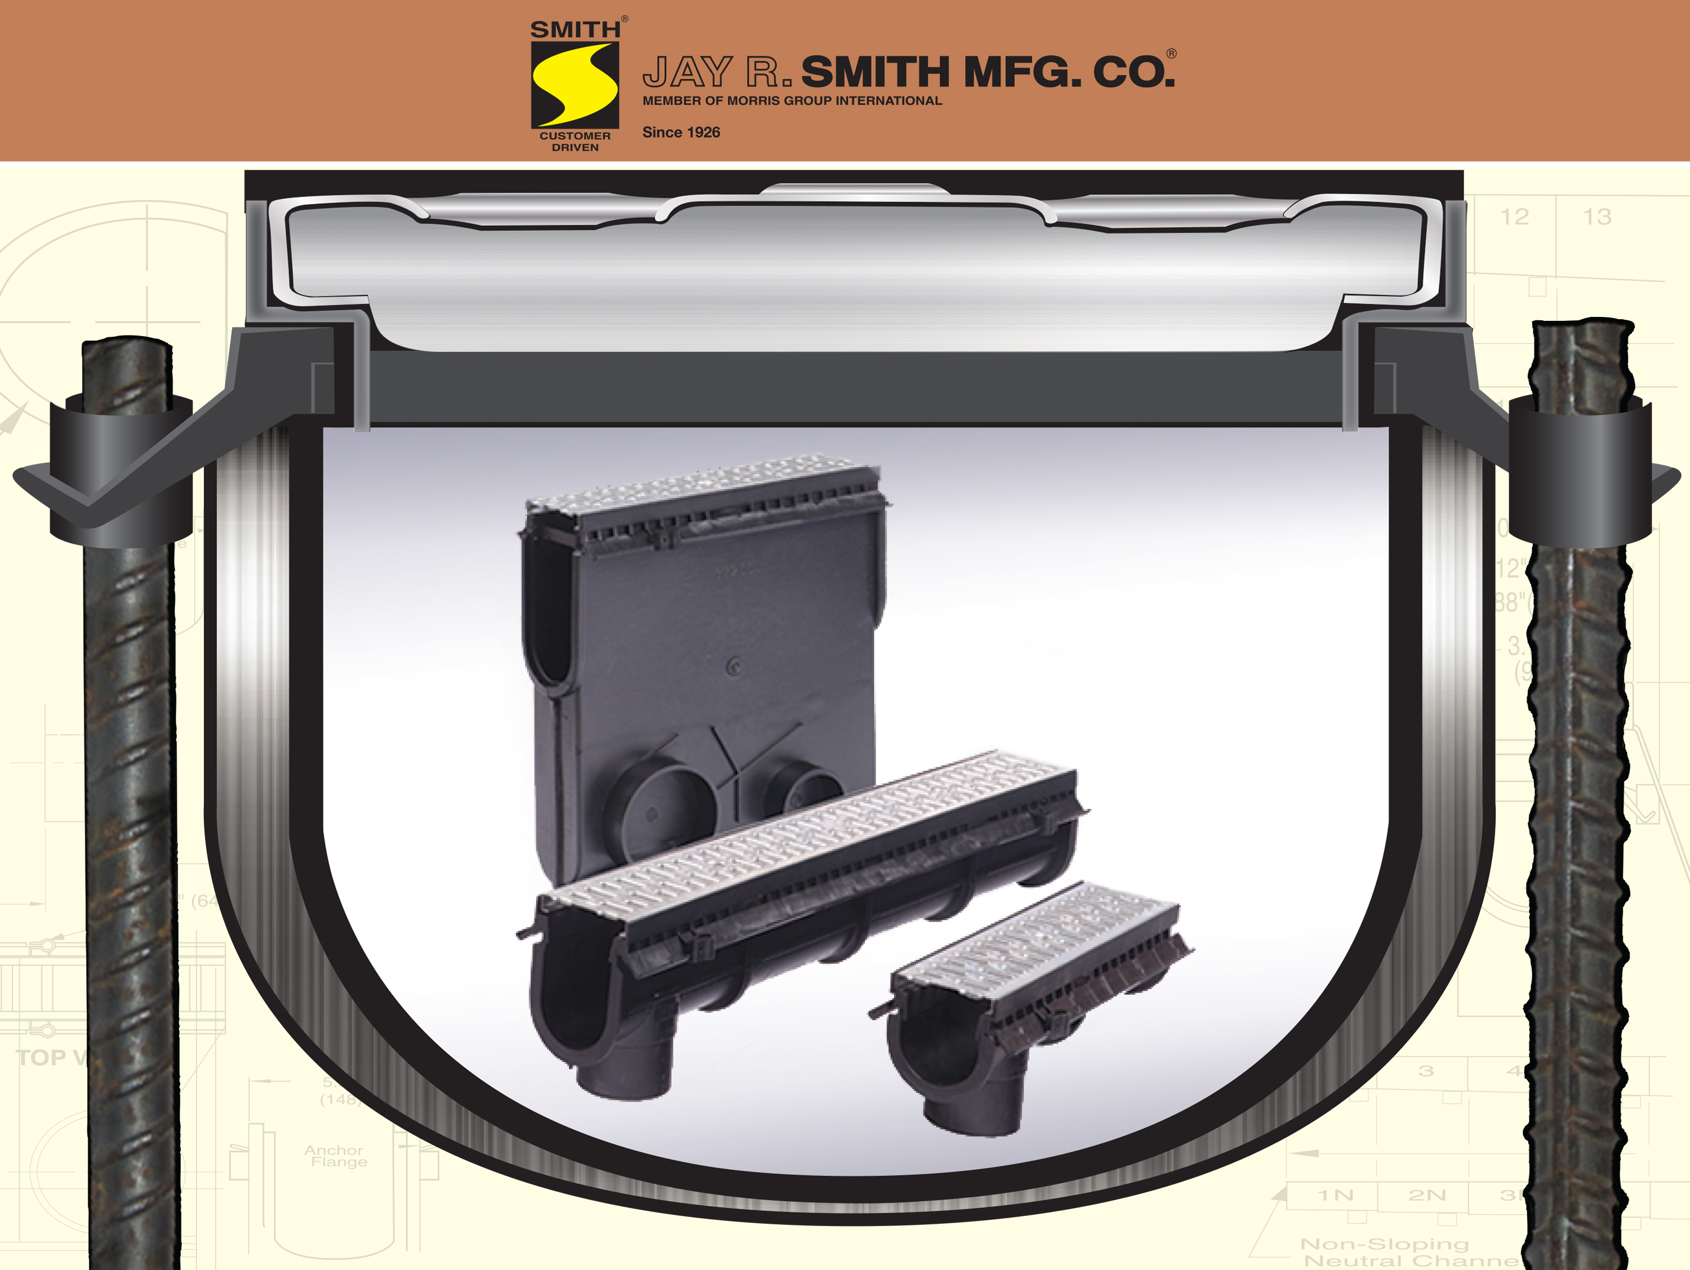
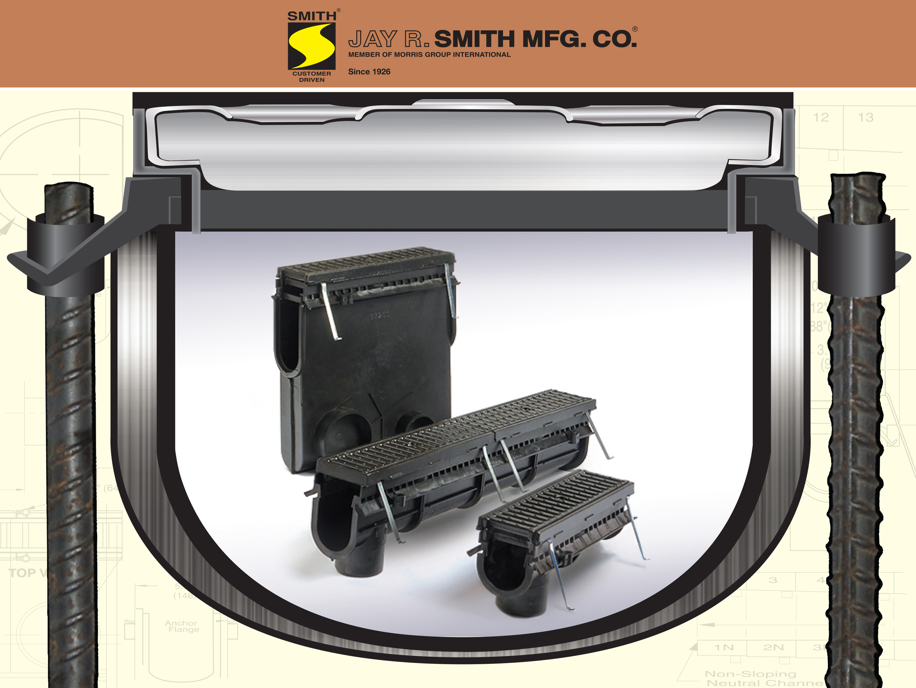
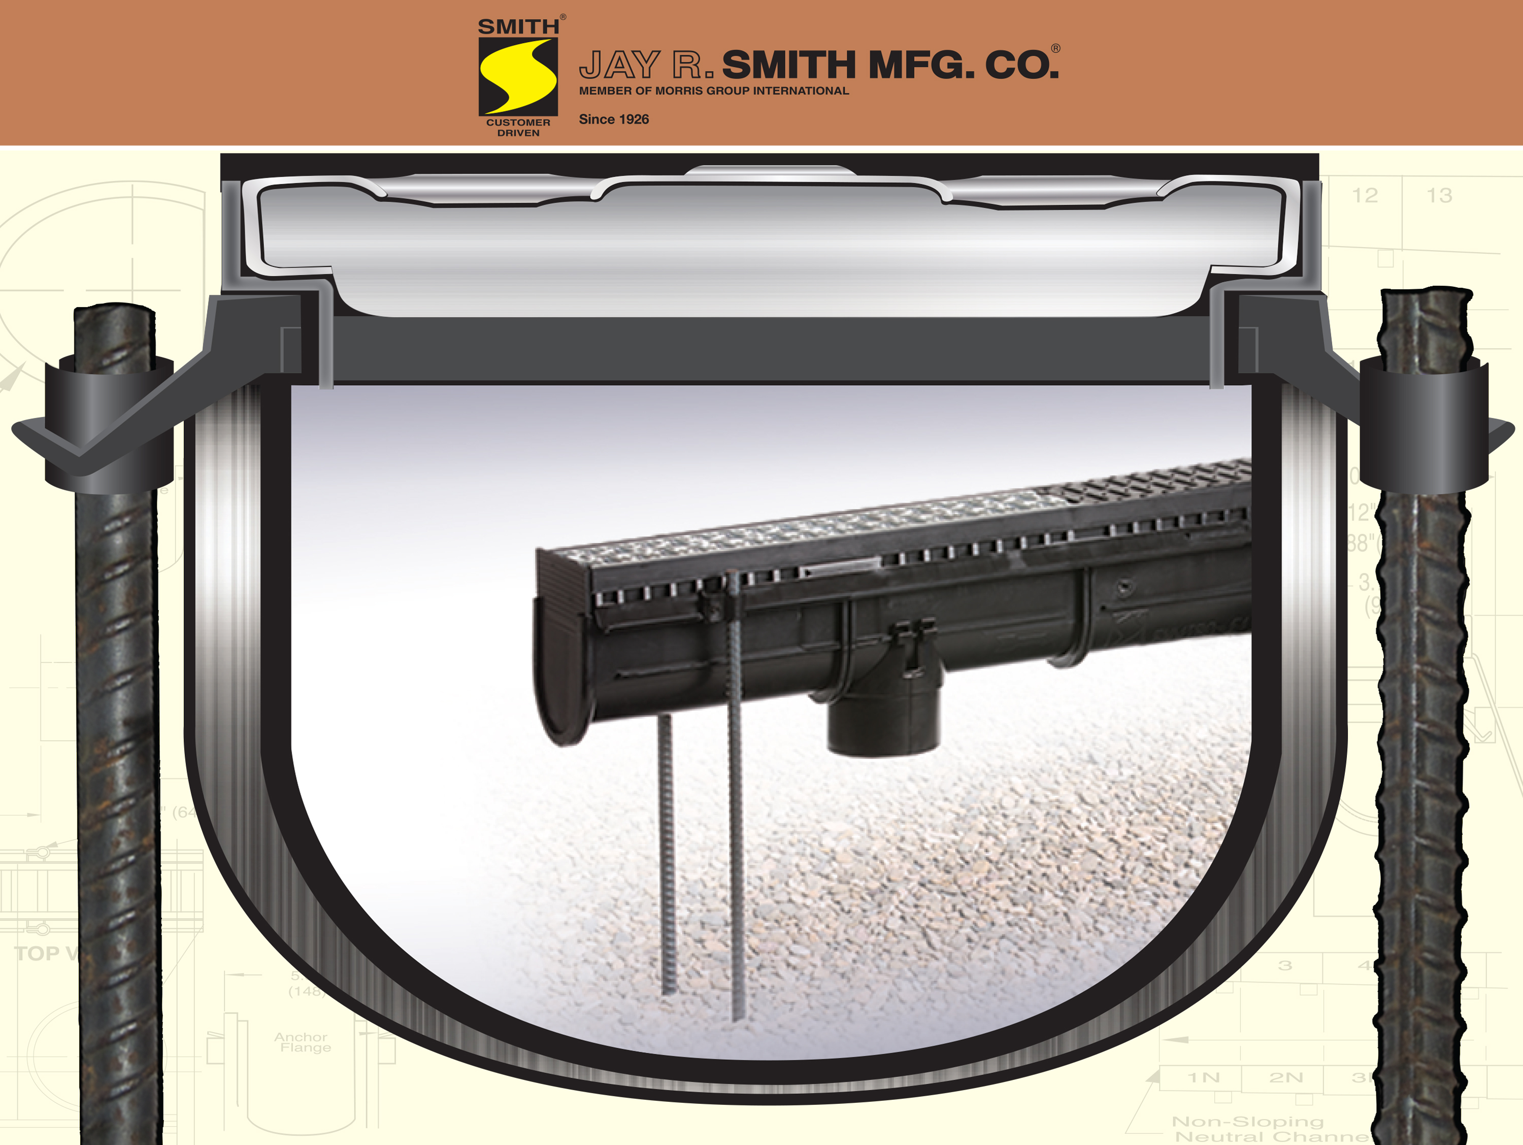
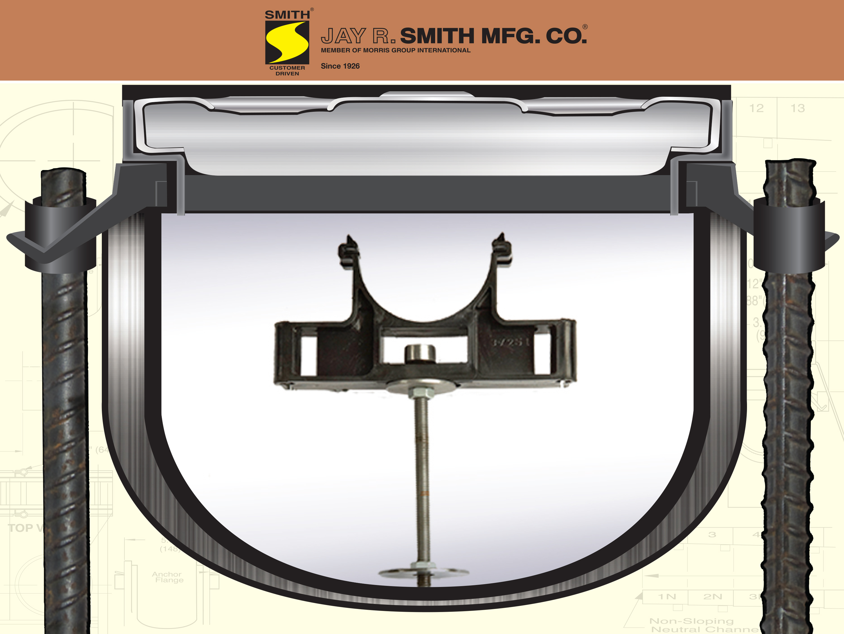
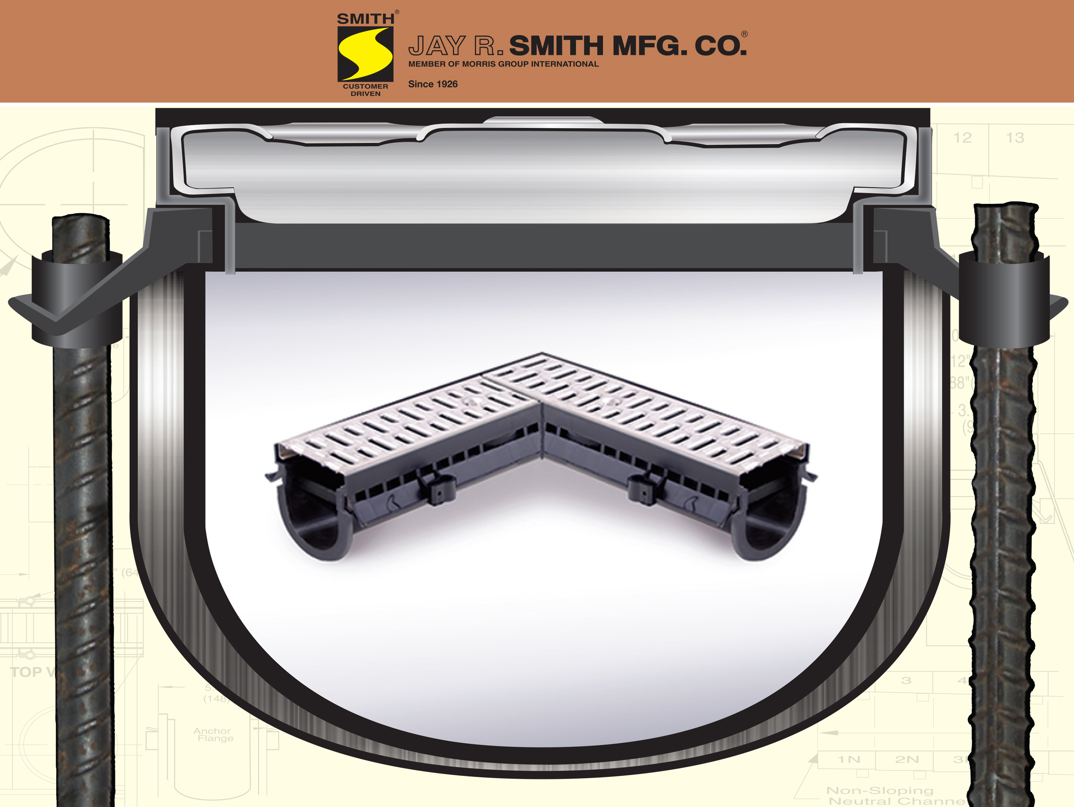
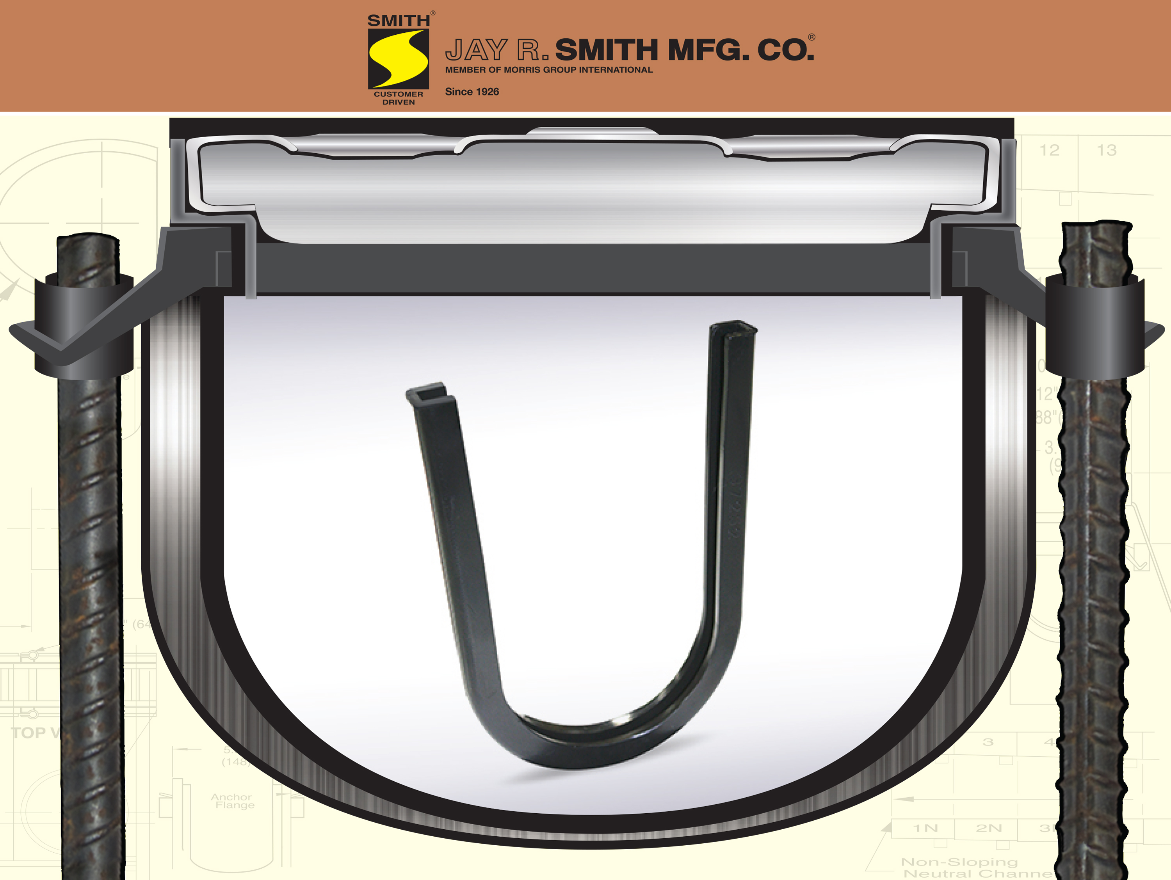
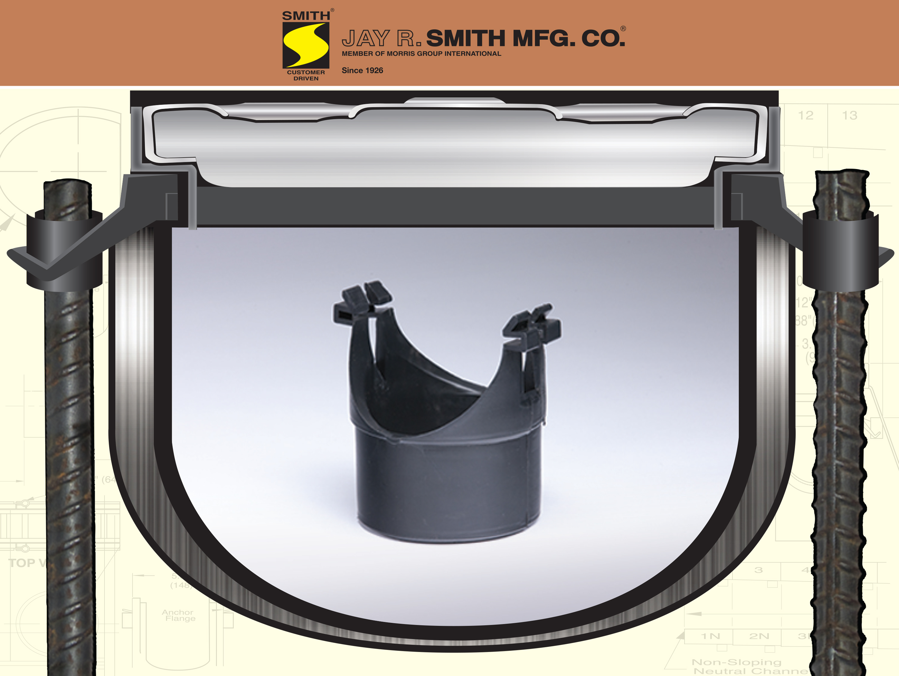
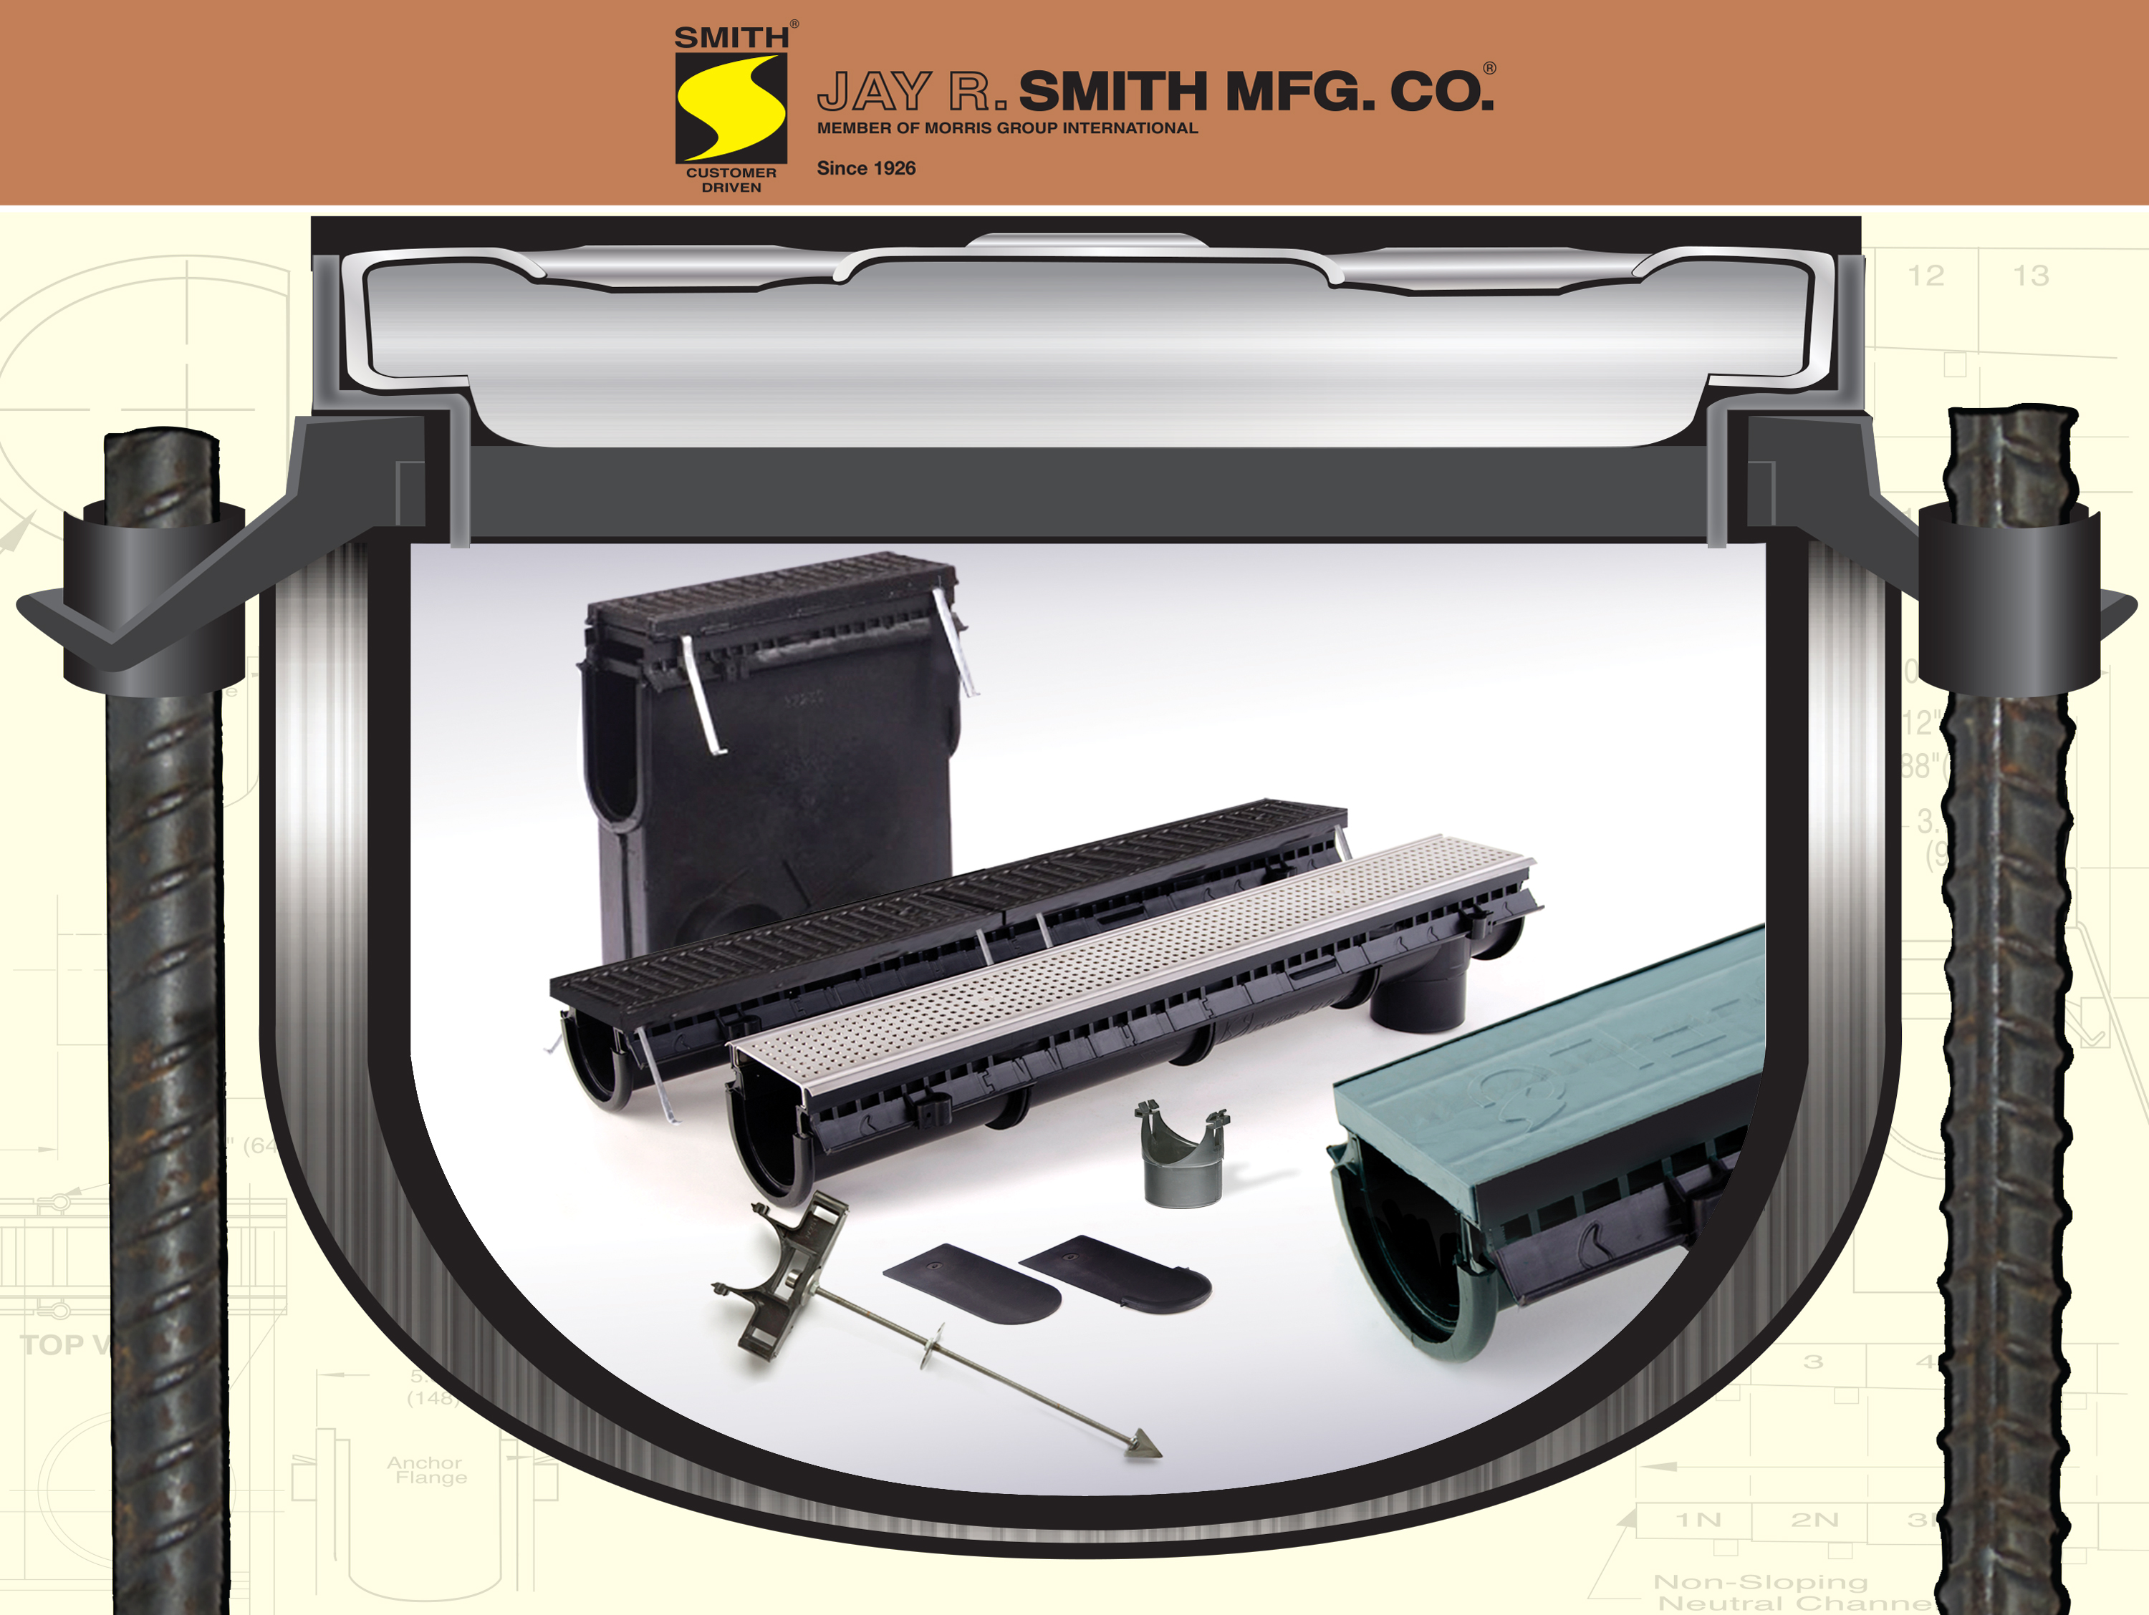
Enviro-Flo II Trench Drain Series
®
Integral Rebar Mount
The New Enviro-Flo II
Trench Drain System
9931 Trench
Drain System
9930 Trench
Drain System
No-Hub
Outlet
Male
Coupling
Custom Factory
Fabrications
9849
Rante-Arrow

Slide 2
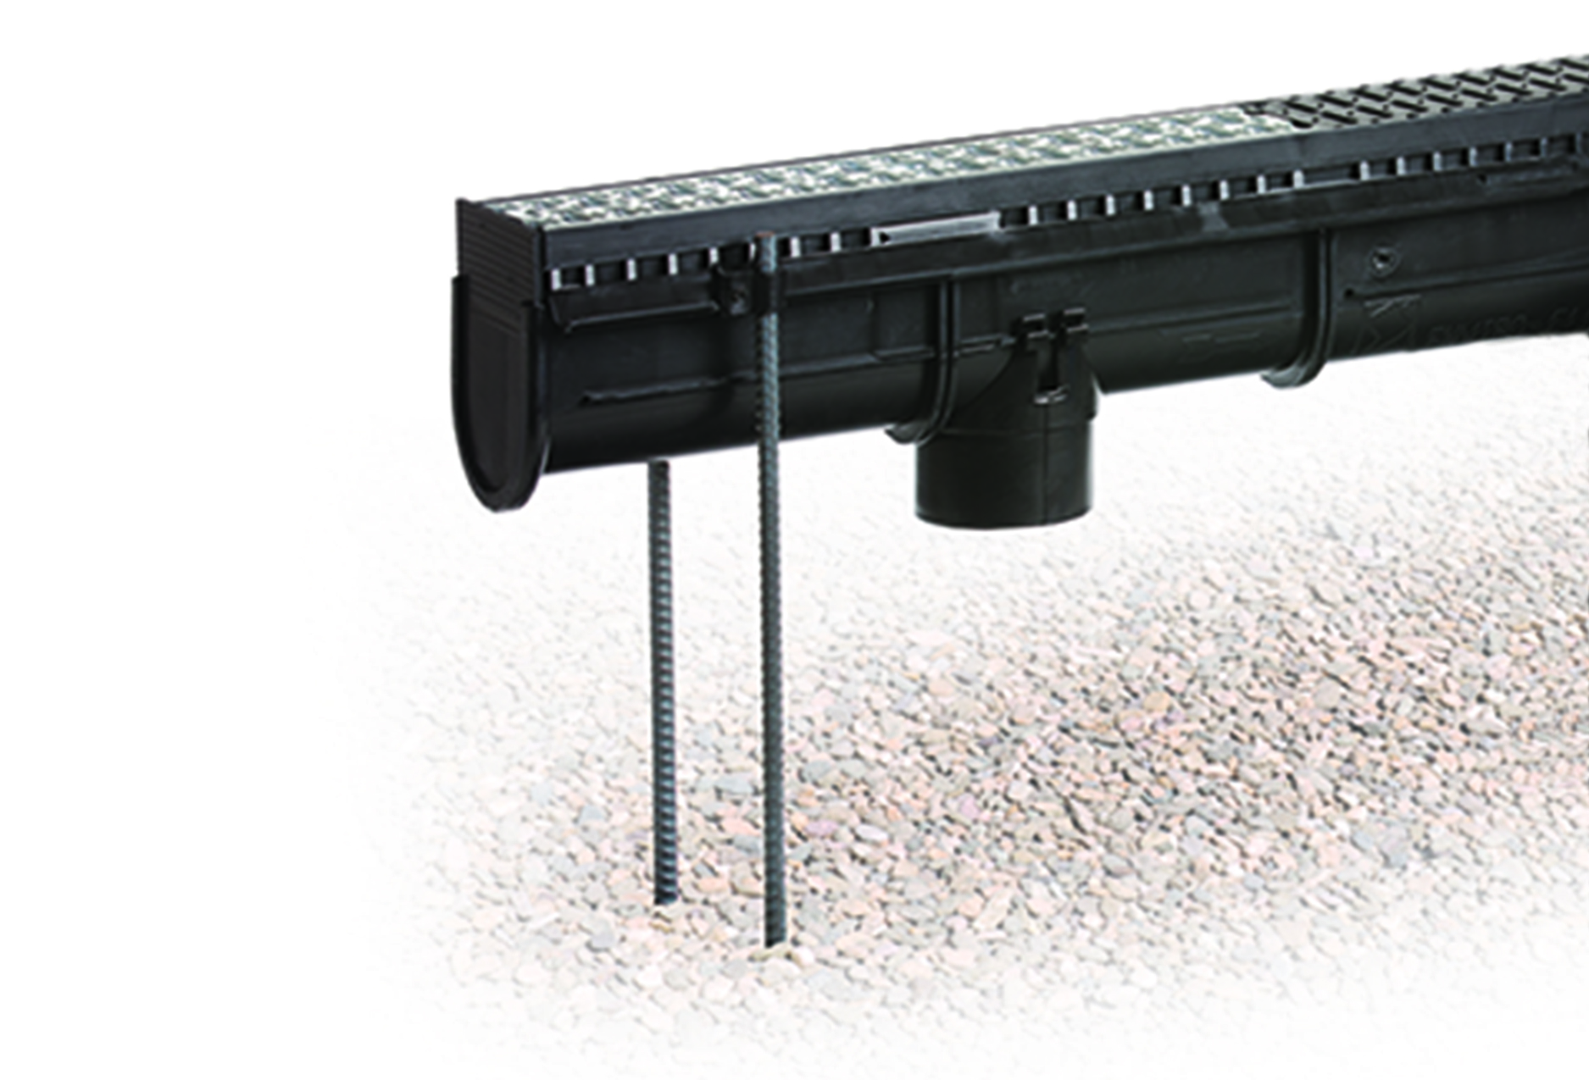
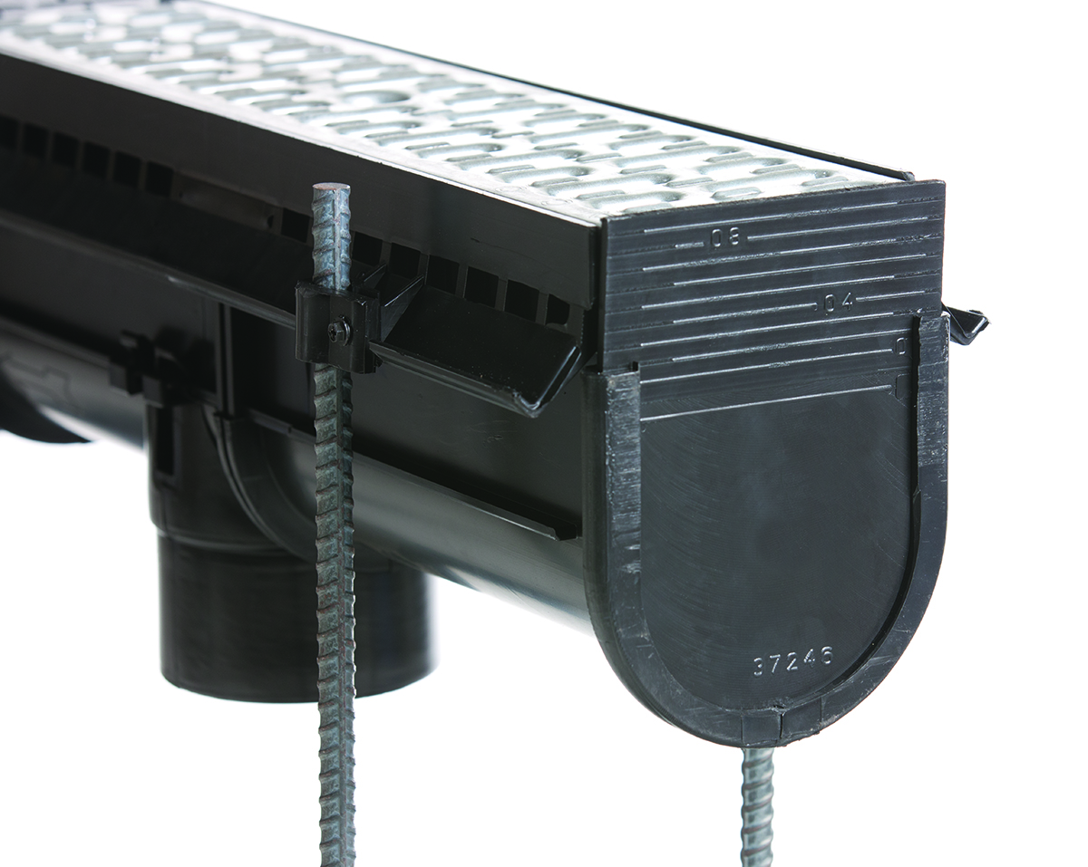
New Features
Enviro-Flo II Trench Drain Series
®
Rebar Anchor Lock Down
Integral Rebar Mount

Slide 3
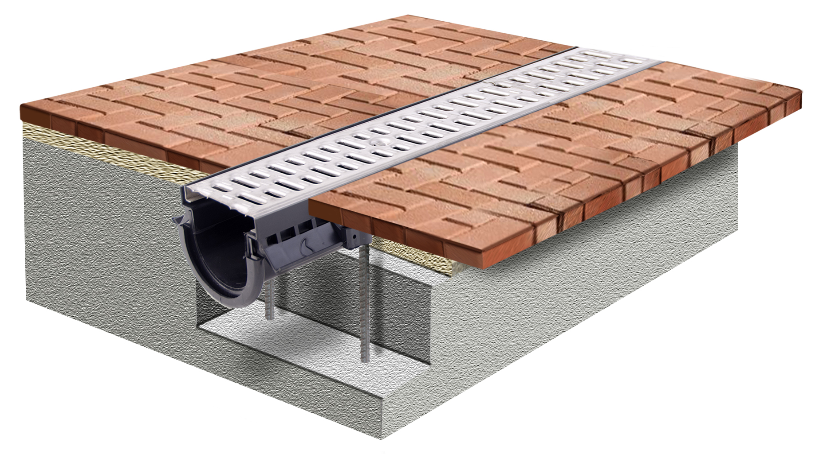
New Features
Enviro-Flo II Trench Drain Series
®
Paver Friendly
Frame

Slide 4
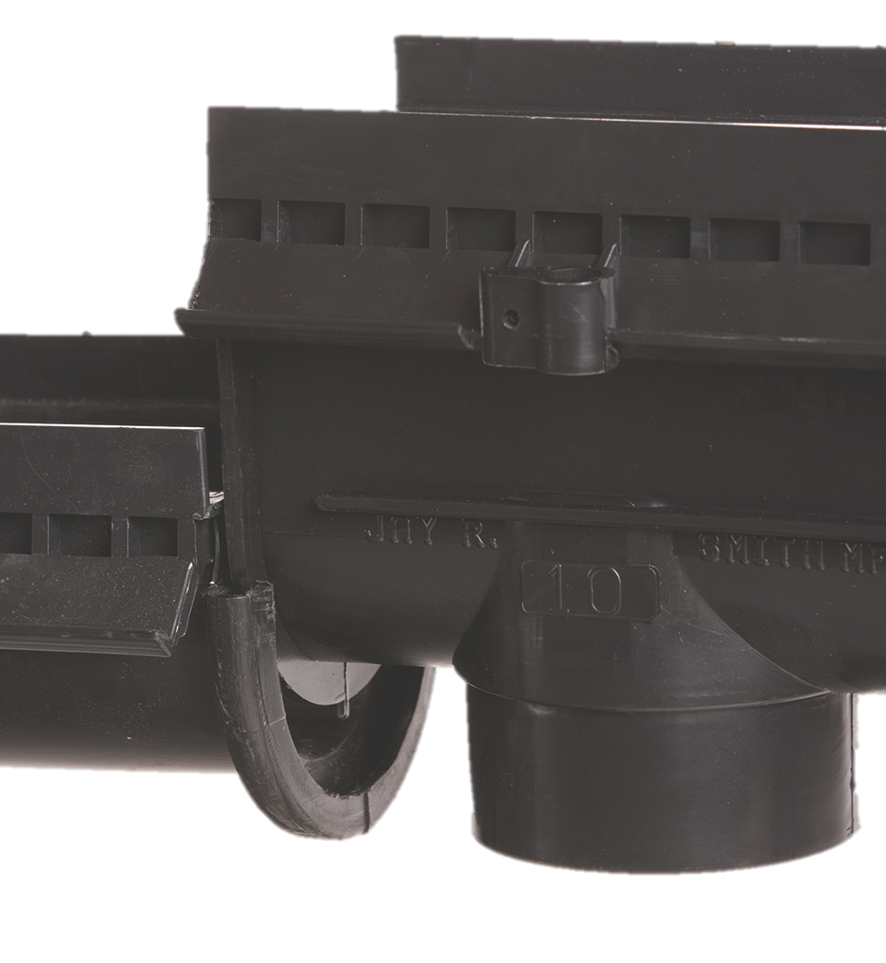
New Features
Enviro-Flo II Trench Drain Series
®
®
Enviro-Loc
Tongue & Groove Connections
Mechanical interlocking joint.
Alignment integrity maintained.
With proper sealant, provides a watertight connection.
No clips or screws needed.

Slide 5
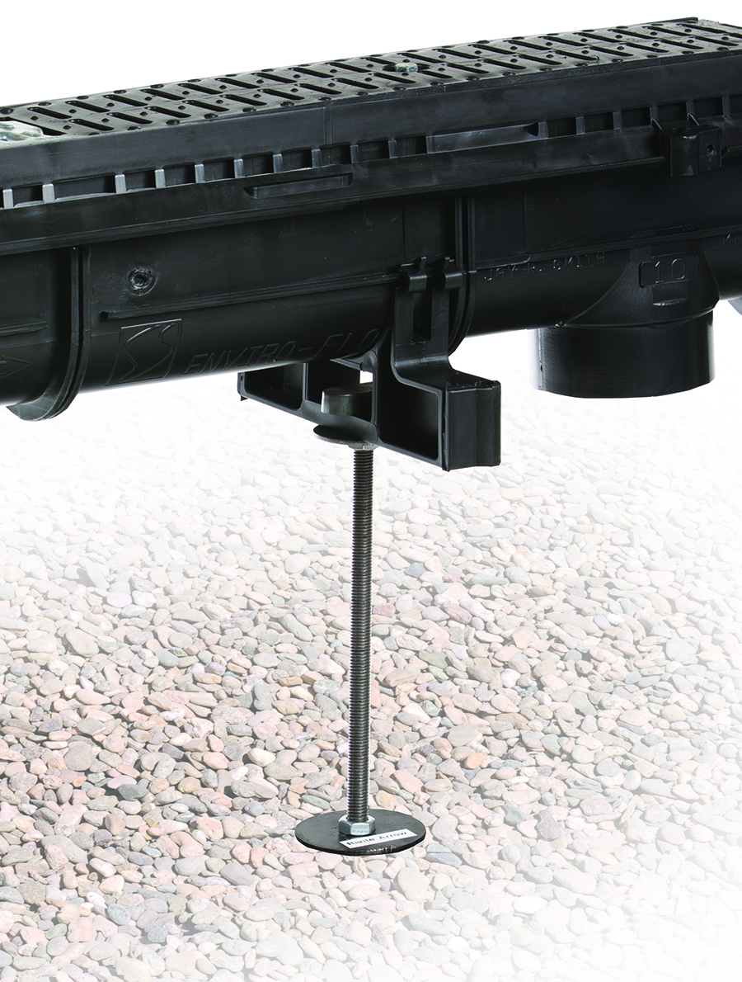
New Features
Enviro-Flo II Trench Drain Series
®
9849 Rante-Arrow Mount
Provides vertical and horizontal adjustments for quick and easy leveling.

Slide 6
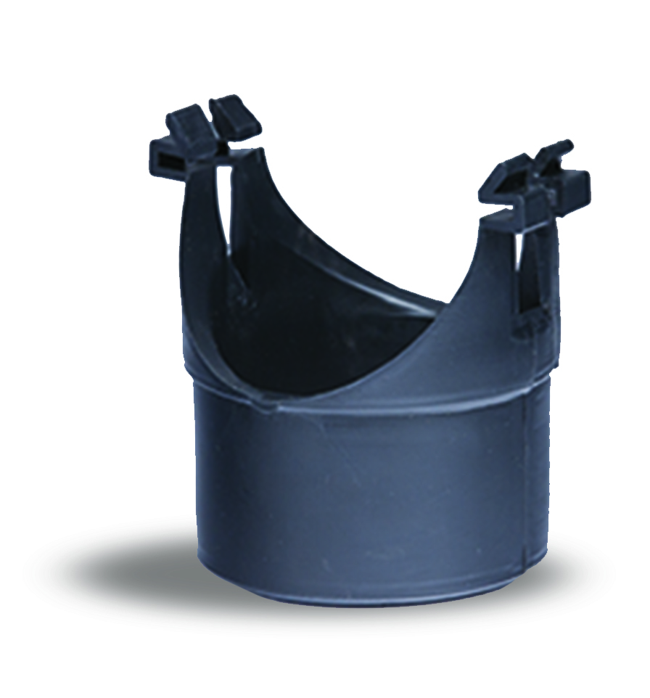
New Features
Enviro-Flo II Trench Drain Series
®
No-Hub Outlet
The vertical outlet attaches to the Enviro-Flo II accessory rail to create an outlet anywhere on the channel.

Slide 7
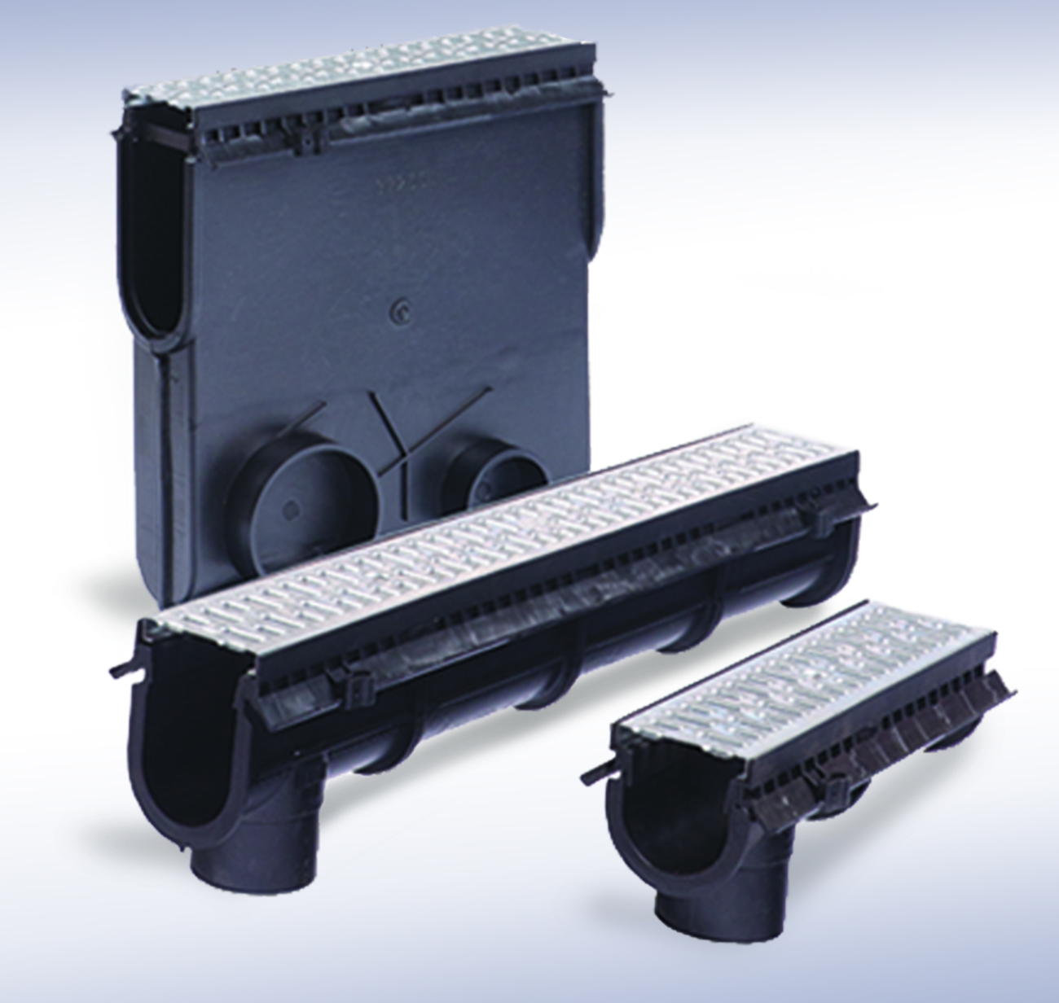
9930 Trench Drain System
Enviro-Flo II Trench Drain Series
®
System Length 65’-7 ½”
Up to 20 sloping and 20 neutral
1 Meter recycled polypropylene channels.
Pre-sloped sections are sloped
at .06%.
Male and Female tongue and groove connectors with no clips
or screws needed.
Universal shallow or deep
end caps available as well as
a 4” outlet cap.

Slide 8
9930 Trench Drain System
Enviro-Flo II Trench Drain Series
®
System Length 65’-7 ½”
Quicklok® grates standard
Integral Rebar or Rante-Arrow Mounting System
Make adjustments and connections in the field with adapters and accessories.
Load Class C with appropriate grating
No-Hub outlet adaptor

Slide 9
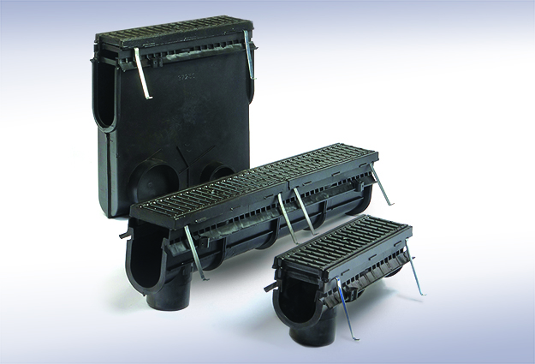
9931 Trench Drain System
Enviro-Flo II Trench Drain Series
®
System Length 65’-7 ½”
Uses 9930 channel with the addition of ductile iron frames
and ductile iron slotted grates.
Up to 20 sloping and 20 neutral
1 Meter recycled polypropylene channels.
Suitable for hard wheel
forklift use
Pre-sloped sections are
sloped at .06%.
No-Hub outlet adaptor

Slide 10
9931 Trench Drain System
Enviro-Flo II Trench Drain Series
®
System Length 65’-7 ½”
Male and female tongue and groove connectors with no clips
or screws needed.
Universal shallow or deep
end caps available as well as
a 4” outlet cap.
Make adjustments and connections in the field with adapters and accessories.
Integral Rebar or Rante-Arrow Mounting System
Load Class E with appropriate rating.

Slide 11
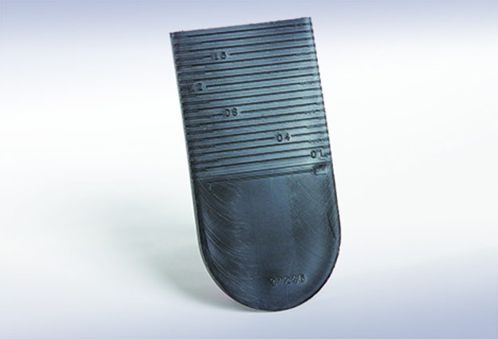
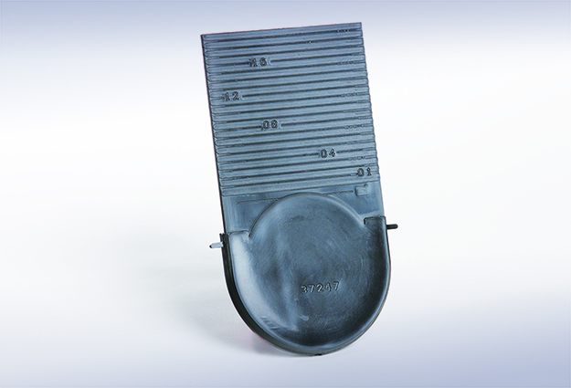
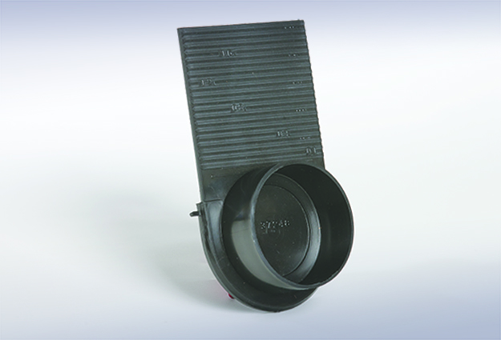
Accessories
Enviro-Flo II Trench Drain Series
®
Shallow End-Cap
Shallow end caps accommodate the shallow end of the channel and feature a cutting guide for a perfect fit.
Deep End-Cap
Deep end caps accommodate the deep end of the channel and feature a cutting guide for a perfect fit.
Horizontal Outlet Cap
This end cap fits channels #10-20N and creates a horizontal outlet.

Slide 12
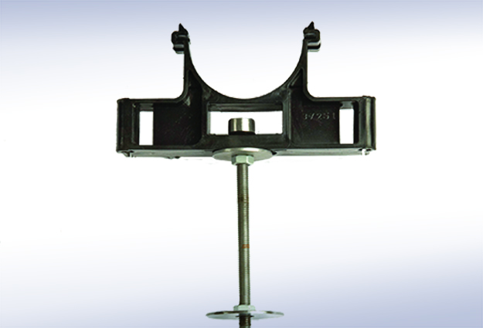
Accessories
Enviro-Flo II Trench Drain Series
®
9849 Rante-Arrow Mount
The 9849 Rante-Arrow is designed for use
with 9930 and 9931 systems. The 9849
Rante-Arrow firmly anchors the channel system in most sub-base conditions, eliminating floating and allowing for
a monolithic pour. Provides vertical
and horizontal adjustments for quick and
easy leveling.

Slide 13
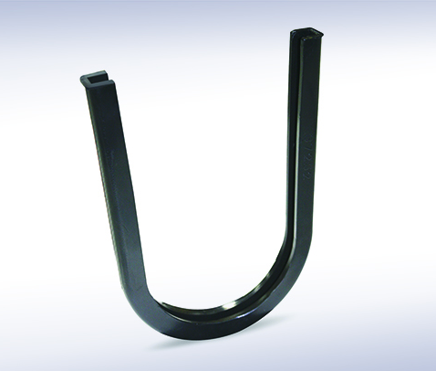
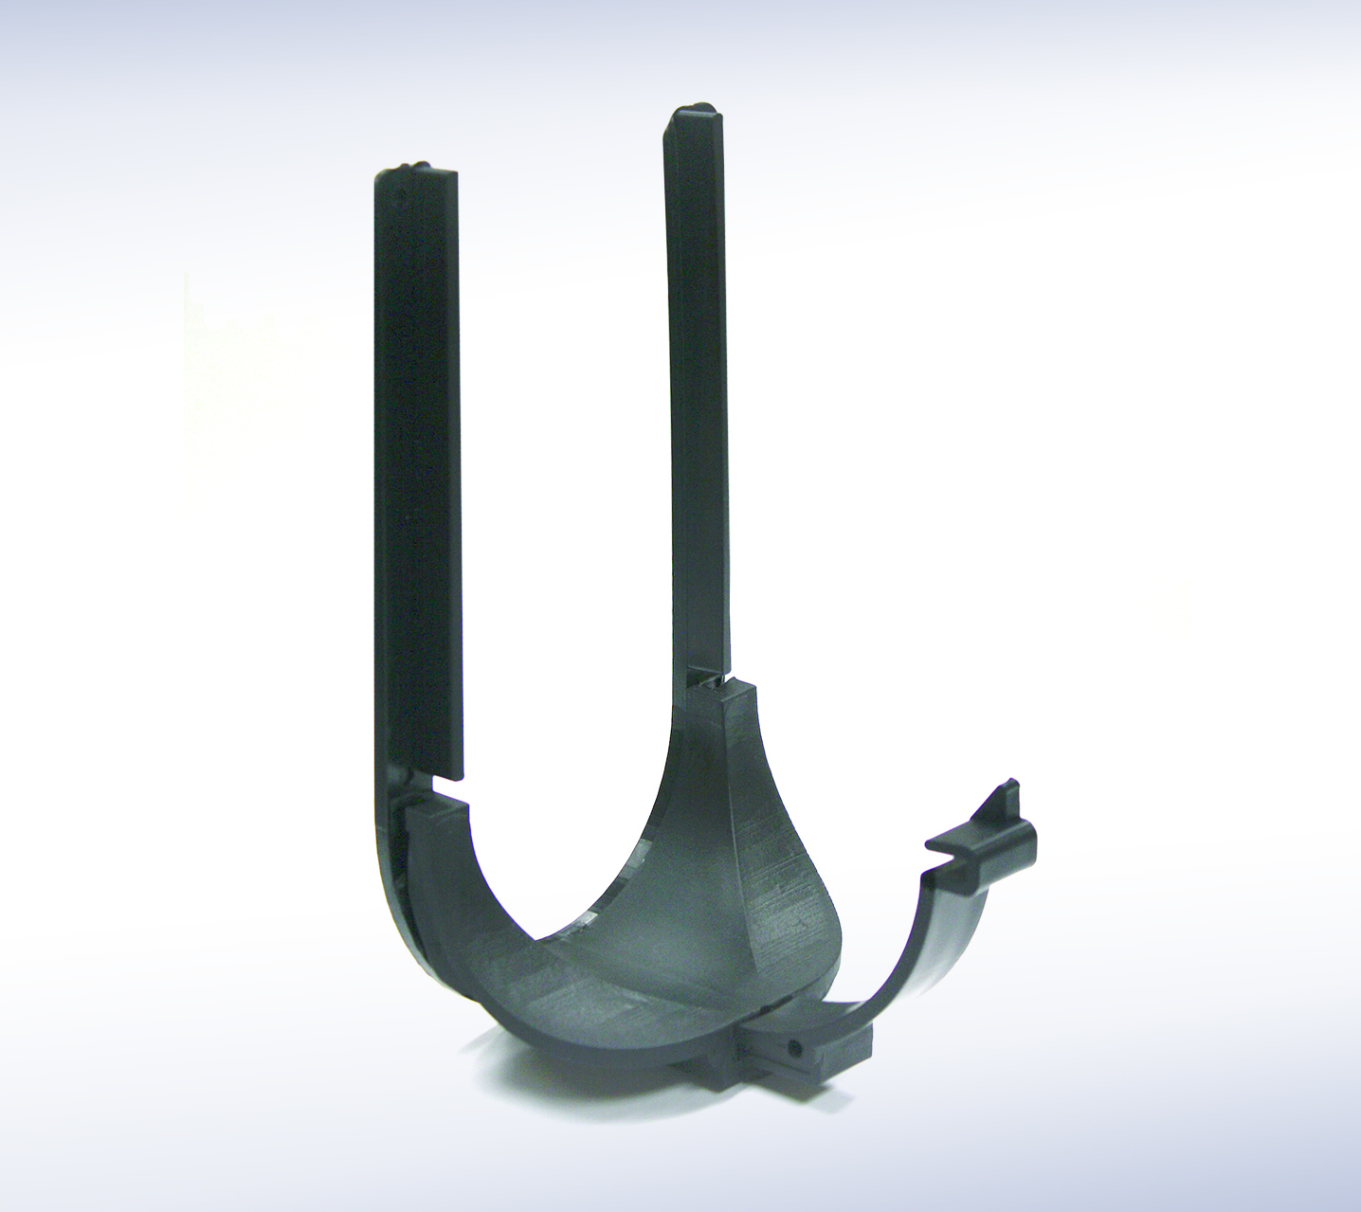
Accessories
Enviro-Flo II Trench Drain Series
®
Male Coupling
The male coupling allows two male channel
ends to be joined together, offering contractors greater flexibility to make adjustments in the field.
Tee Connection
The tee connection allows contractors to make quick and easy tee connections in the field.

Slide 14
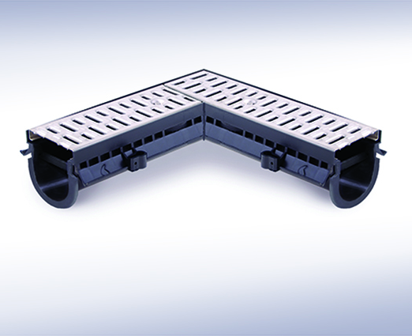
Accessories
Enviro-Flo II Trench Drain Series
®
Custom Factory Fabrications
Factory fabrications are available upon request and are designed and manufactured to meet your specific requirements.

Slide 15
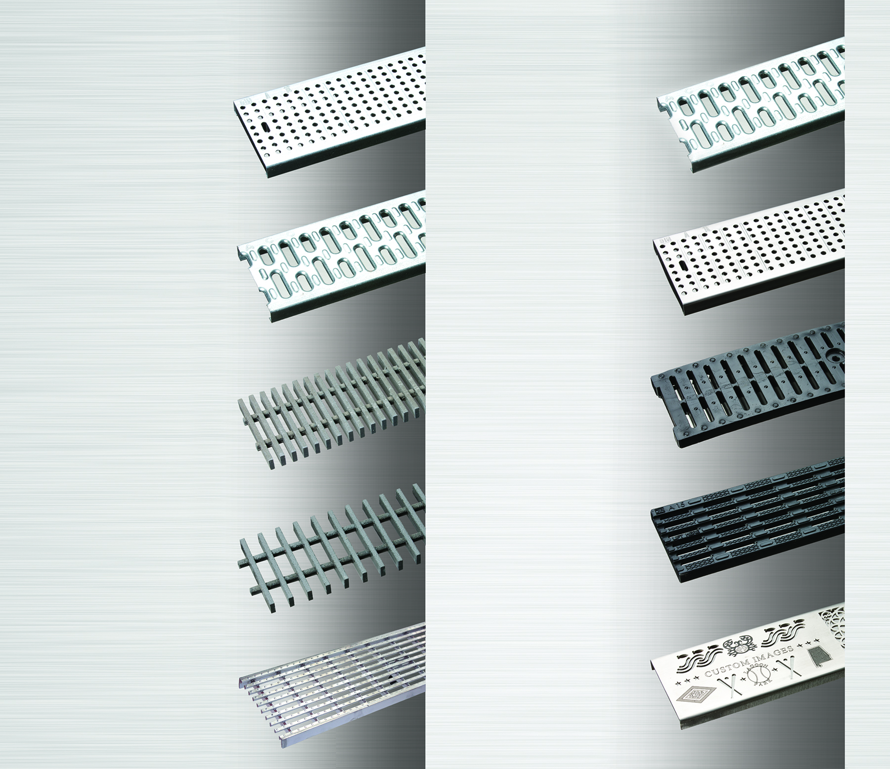
9870 Grates – Light Duty
Enviro-Flo II Trench Drain Series
®
Light Duty, DIN 19580 Class A - 3,500 lbs. - 70 psi
Pedestrian, Wheelchair & Bicycle Traffic
9870-410-GP
Perforated Galvanized Steel
9870-450-SS
Slotted Stainless Steel
9870-420-G
Slotted Galvanized Steel
9870-451-SSPA
Perforated Stainless Steel
9870-440-VF
Vinylester Fiberglass
9870-491-HPP
Slotted Black Polypropylene
9870-440-VF2
Vinylester Fiberglass
9870-494-PADAB
ADA Black Polypropylene
Available in Gray, Brick Red and Green colors.
9870-447-SSADA
ADA Stainless Steel
Custom Image Trench
Drain Grate

Slide 16
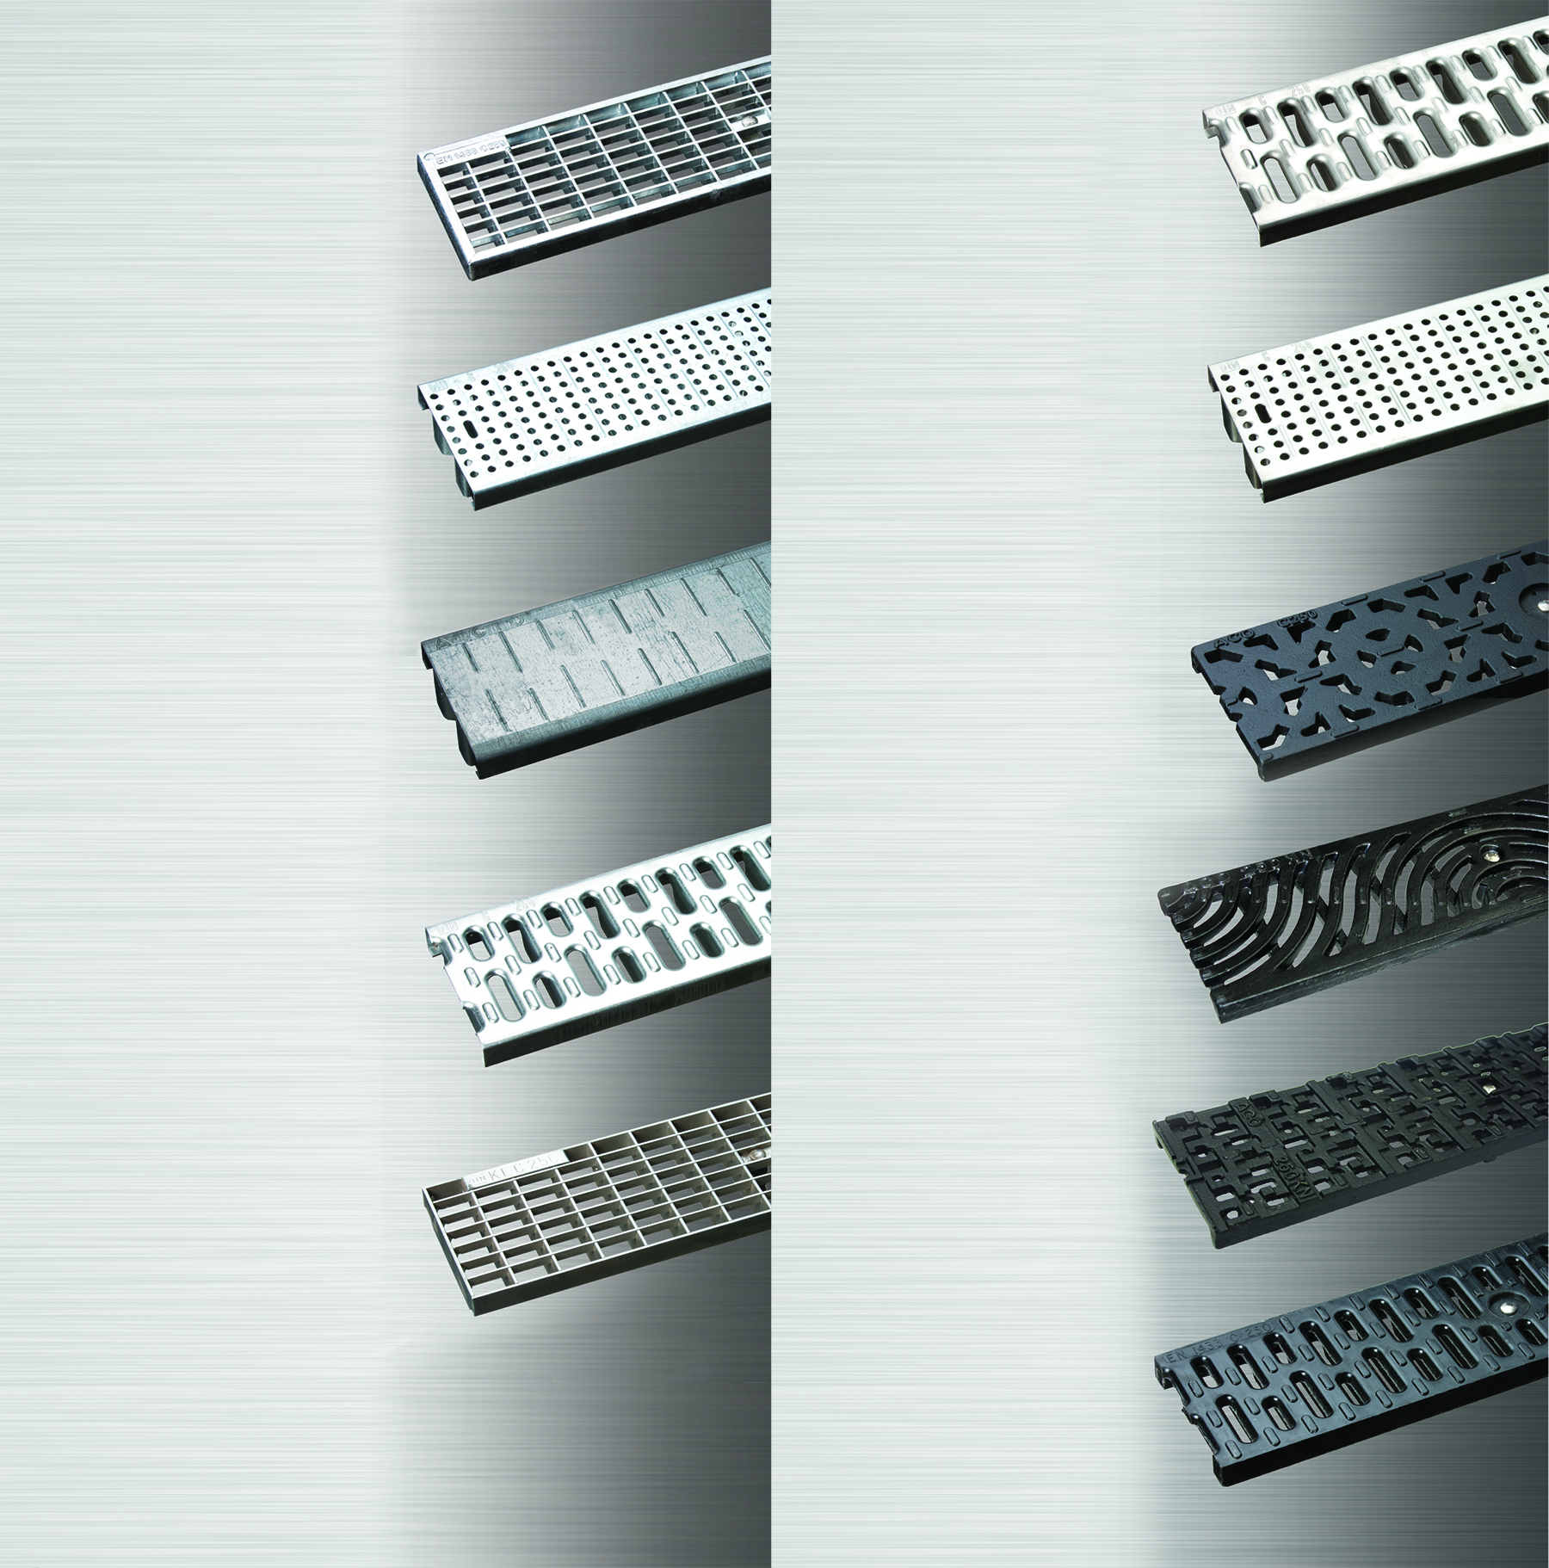
9870 Grates – Heavy Duty
Enviro-Flo II Trench Drain Series
®
Heavy Duty, DIN 19580 Class C - 56,000 lbs. – 1,162 psi
Commercial pneumatic tire traffic patterns, forklifts, and tractor trailers
9870-405-GM
Mesh Galvanized Steel
9870-455-SSHD
Slotted Stainless Steel
9870-411-GPHD
Perforated Galvanized Steel
9870-465-SSP
Perforated Stainless Steel
9870-416-GS
Solid Galvanized Steel
9870-479-MD
MOSAIC Ductile Iron
9870-425-GHD
Slotted Galvanized Steel
9870-480-IW
Iron Wave
9870-430-SSM
Mesh Stainless Steel
9870-480-ID
Iron Decorative
9870-492-RC
Resin Composite

Slide 17
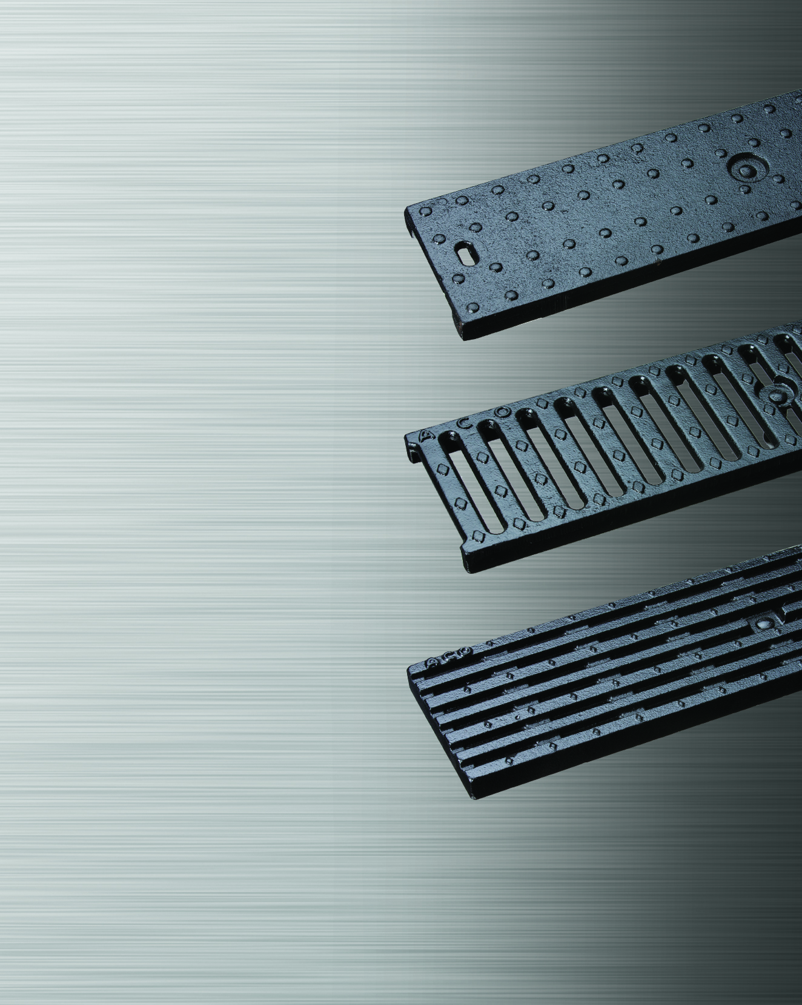
9870 Grates – Extra Heavy Duty
Enviro-Flo II Trench Drain Series
®
* Extra Heavy Duty, DIN 19580 Class E - 135,000 lbs. - 2,788 psi
Commercial solid tire traffic patterns, forklifts and impacts from steel struts or metal wheels.
9870-456D-MS
Solid Ductile Iron
9870-461-M
Slotted Ductile Iron
9870-477-MADA
* Only meets Class E Rating when used with 9931 Series Ductile Iron Frame.

Slide 18
Enviro-Flo II Trench Drain Series
®
For more information or help with Trench Drain
questions/issues, please contact us at:
Customer Service/Orders
Ext. 235 Cathy, cathy.vardaman@jrsmith.com
Technical Information/Layout drawings
Ext. 225 Pace, pace.josey@jrsmith.com
Ext. 283 Mike, mike.donley@jrsmith.com
Pricing/Technical/Market Information
Ext. 302 Mario, mario.stan@jrsmith.com
(800) GO-SMITH (334) 277-8520
www.jrsmith.com

Slide 19

THANK YOU
FOR YOUR TIME!
Plumbing and Drainage Products
P.O. Box 3237
Montgomery, AL 36109-0237
JAY R. SMITH MFG. CO.
Member of Morris Group International
Enviro-Flo II Trench Drain Series
®
Tel. 800-GO-SMITH www.jrsmith.com

