Slide 1
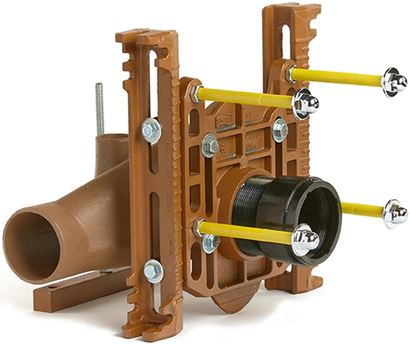

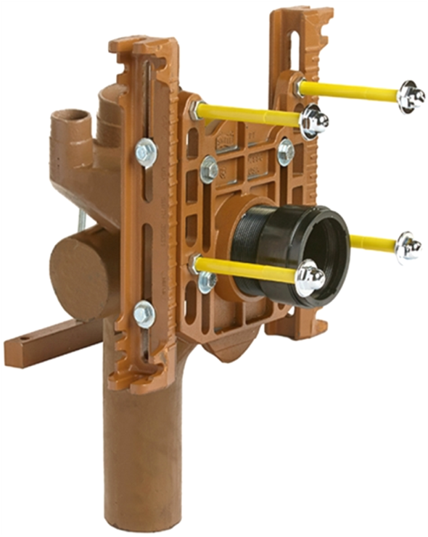
0211Y-M54-XX
SALES PRESENTATION:
0240Y-M54-XX
WATER CLOSET SUPPORTS

Slide 2

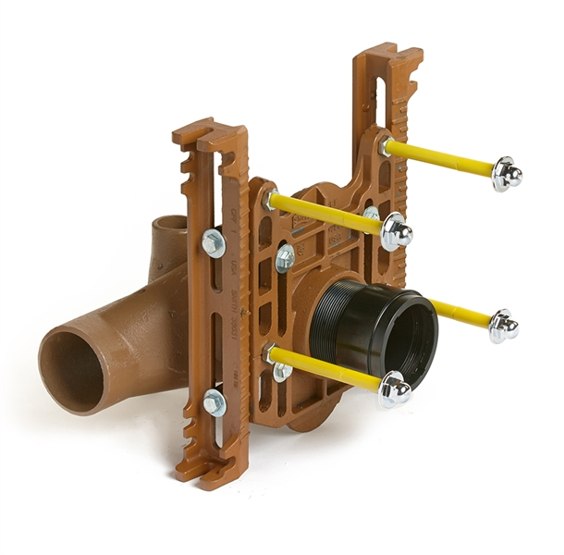
THE AGENDA
THE PROBLEM
THE SOLUTION
BENEFITS
ITEMS TO REMEMBER
SETTINGS
FEATURES
BATTERY PREFABRICATION
OPTIONAL ACCESSORIES
HOW TO SELECT A WATER CLOSET
SPECIFICATIONS
APPLICATIONS
CERTIFICATIONS & LISTINGS
SUMMARY
ANY QUESTIONS?
0211Y-M54

Slide 3
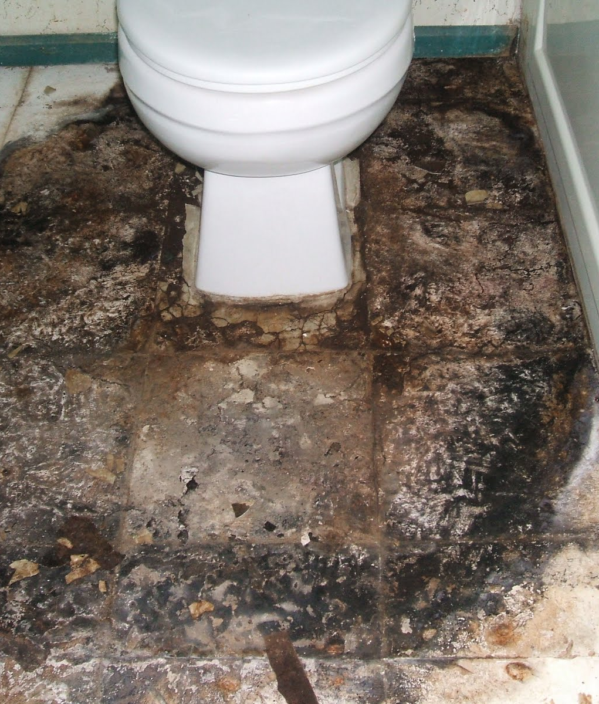
THE PROBLEM
Public restrooms can be difficult to maintain and keep clean.
ARCHITECTS want to control building costs and ensure structurally sound designs by selecting proper water closet supports.
CONTRACTORS want products that save time and reduce installation costs during construction.
CUSTOMERS insist on the best value for their investment and expect a high level of sanitation.

Slide 4
THE SOLUTION
OFF-THE-FLOOR
WATER CLOSET SUPPORTS
LABOR SAVING water closet supports for various installation applications.
Application VERSATILITY for metal stud, block, or narrow wall chase configurations.
REDUCED MAINTENANCE and cleaning costs.
0211Y-M54

Slide 5
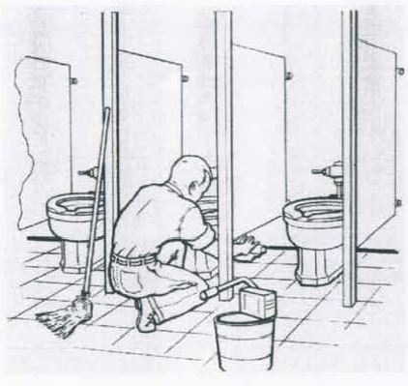
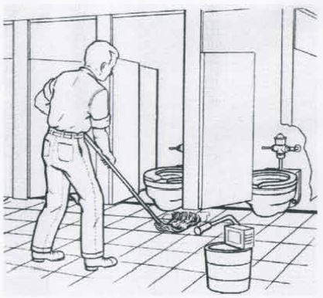

BENEFITS
MORE ECONOMICAL than conventional floor mounted units.
LESS SLEEVING: only one sleeve required for vertical inlet fitting.
NO SCAFFOLDING OR LADDERS.
FASTER INSTALLATION: the installer works on the floor rather than in the ceiling below.
No more DROPPED CEILINGS, saving on construction costs.
SANITATION: Mops pass more easily beneath “off the floor” mounts, reducing sanitation hazards and cleaning costs. (see right)
VS.

Slide 6
ITEMS TO REMEMBER
PIPE CONNECTIONS (TWO TYPES)
NO-HUB (Mechanical Joint).
CAULK (Hub & Spigot).
SIPHON JET SUPPORTS
Requires FOUR STUDS to mount.
BLOWOUT SUPPORTS
Requires THREE STUDS to mount.
NOTE: Adjustable Horizontal Supports maintain the proper pitch (slope) in a battery installation.
0211Y-M54

Slide 7
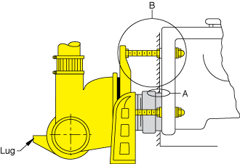
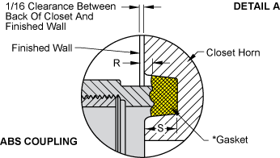
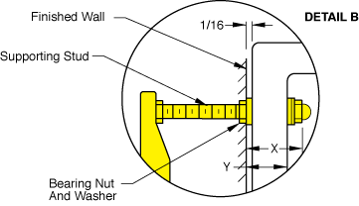
SETTINGS
Closet Horn Depth and
Flange Thickness:
Fixture support closet connection should extend 5/16” beyond face of wall. (DIMENSION “R”)
Studs should extend 2 ¼” .
(DIMENSION “X”)
Use DETAIL A (to the left) for exact dimensions.
NOTE: Closet gasket must be compressed for gas and water tight seal.
DETAIL A S + 1/16” – D = R
R = Distance coupling should extend beyond finished wall.
S = Depth closet horn.
1/16” = Distance closet is to set away from finished wall.
*D = ½” for felt gasket and 3/8” for neoprene gasket.

Slide 8
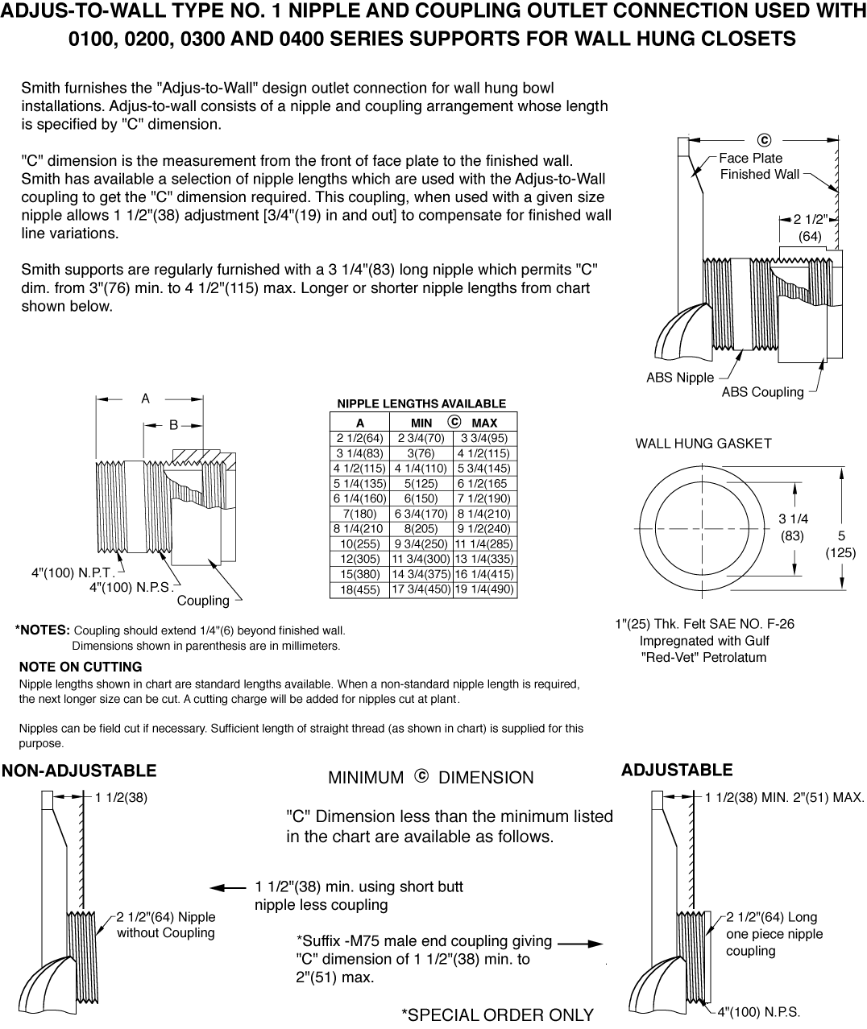
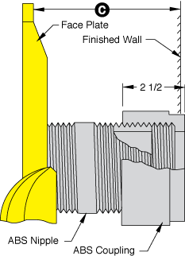
SETTINGS
CONT’D

Slide 9
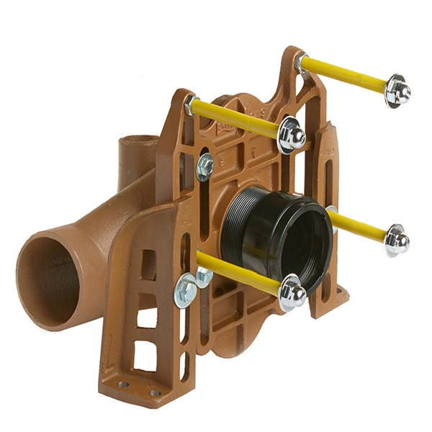
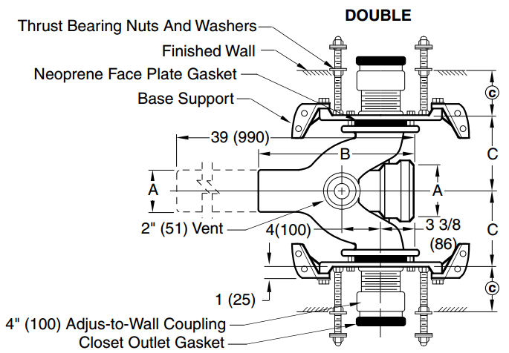
Figure No. 0210Y: Adjustable fixture supports for siphon jet water closets shallow rough-in type
FEATURES
AN OVERVIEW
ADJUSTABLE horizontal/vertical fitting supports.
WIDE RANGE OF APPLICATIONS, from metal stud to block walls.
VERSATILE: Designed to fit in wall chase from 12-18 inches.
Available with
NO-HUB & CAULK CONNECTIONS.
Figure No. 0210DY
Top View

Slide 10
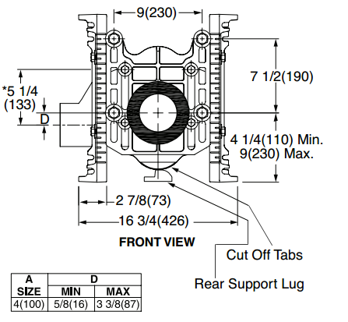
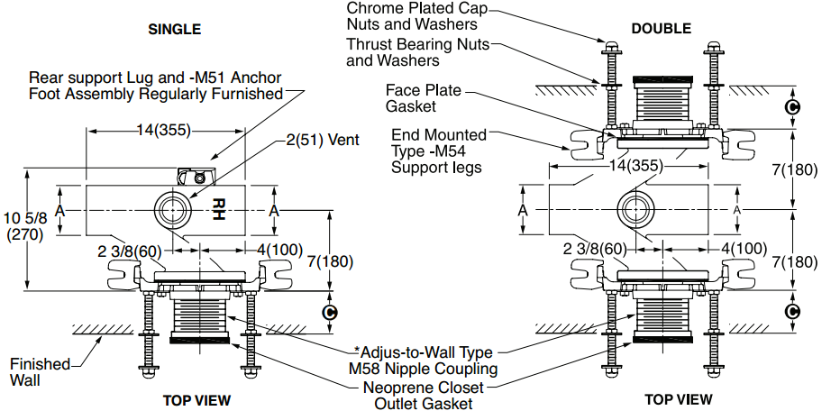
…MORE FEATURES
Typical SMITH Fixture Support with Waste Fitting QUARTERBACK®
Figure No. 0211Y-M58-M54

Slide 11
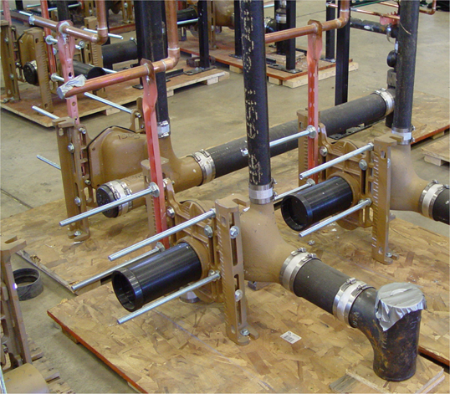
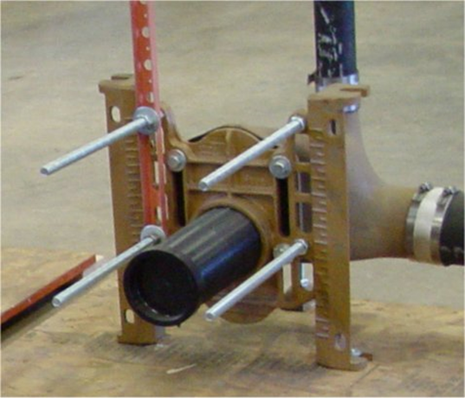
BATTERY PREFABRICATION
0200 Water Closet Support Saves TIME & LABOR
-M54 Side Mounted Leg
-M54-M58 Faceplate w/ “O” Ring Seal
SYMMETRIC construction.
Increased load-bearing.
Half inch incremental markings for quick rough-in.
ADJUSTABLE coupling, nipple, and test cap.
New FACEPLATE adjustment option.
ENHANCED sealing with faceplate “O” Ring.

Slide 12
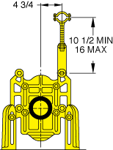
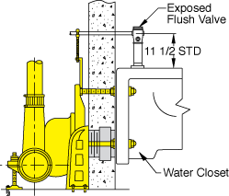
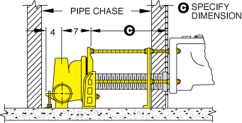
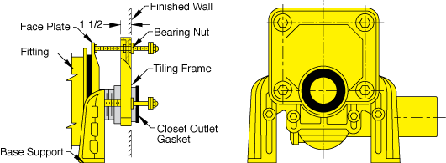
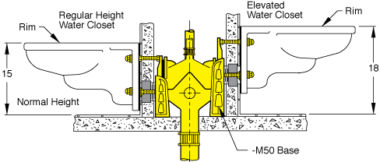
OPTIONAL ACCESSORIES
SUFFIX –M12 EXPOSED FLUSH VALVE SUPPORT
Redesigned with greater strength, a stronger angle clip, and a more rigid stud.
SUFFIX –M40 WATER CLOSET SUPPORT FOR WIDE PIPE CHASE
Provides a set of feet behind wall for extra rigidity.
An alignment yoke ensures proper nipple alignment.
SUFFIX –M13 TILING FRAME
Provides a rim for flat surface tiling.
Available for siphon jet closets only.
SUFFIX –M50 ELEVATED SUPPORT BASE
For back-to-back installations which require a single elevated water closet. Ideal and adaptable for hospitals & nursing homes.

Slide 13
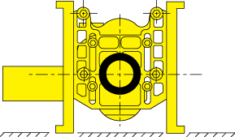
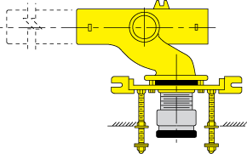
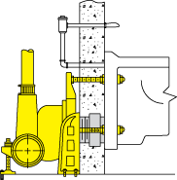
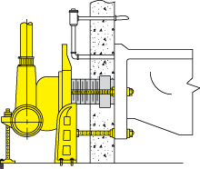
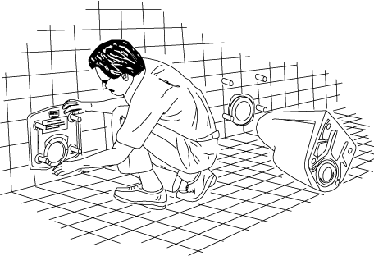
OPTIONAL ACCESSORIES
CONT’D
SUFFIX –M54 FACEPLATE WITH SIDE-MOUNTED BASE SUPPORT ASSEMBLY
FRONT VIEW
TOP VIEW
CONCEALED FLUSH VALVES
Supply pipe enters the rear of the water closet, above the top of the faceplate without interference.
SIPHON JET
BLOWOUT
SUFFIX –M17 WATER CLOSET SETTING GUAGE
Designed to eliminate costly trial and error test mounting.

Slide 14
HOW TO SELECT A
WATER CLOSET
OFF-THE-FLOOR or FLOOR MOUNTED fixture?
SIPHON JET or BLOWOUT WATER CLOSET?
Select VERTICAL FITTING with appropriate SIDE INLETS.
LEFT or RIGHT HAND HORIZONTAL FITTINGS?
Review BATTERY INSTALLATION.

Slide 15
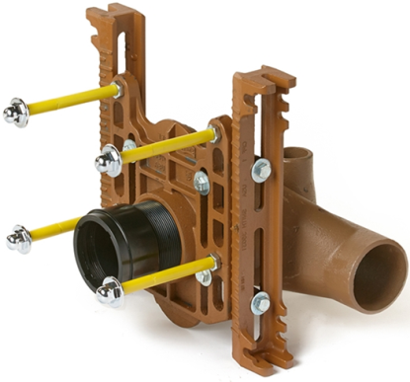
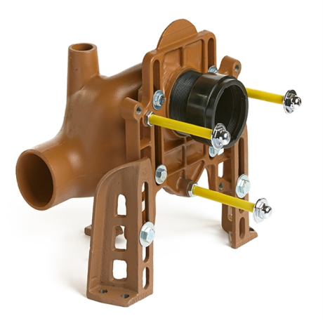
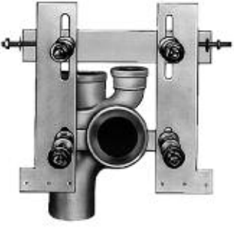
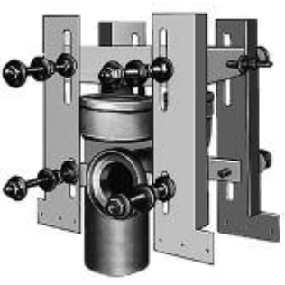
SPECIFICATIONS
WATER CLOSET SUPPORTS
SIPHON JET: Smith No. 0200 series. Adjustable shallow rough-in support for one-pour construction.
BLOWOUT: Smith No. 0300 series. Adjustable rough-in support.
WALL HUNG RESIDENTIAL FLOOR-MOUNT: Smith No. 0550F siphon jet supports. Complete w/ waste fitting and cast iron face plate. Securely bolted to floor construction.
WALL HUNG RESIDENTIAL STUD-MOUNT: Smith No. 0550 stud-mount siphon jet. Steel reinforcing strap transmits top fixture to interior wall, bottom fixture to sole plate.
0211Y-M54
0310Y
WATER CLOSET FITTINGS
FLOOR MOUNTED BACK OUTLET FITTINGS: Smith No. 0200 with Type 2 outlet connection or Smith 0672/0674 stack fittings.
0550 STUD MOUNT

Slide 16


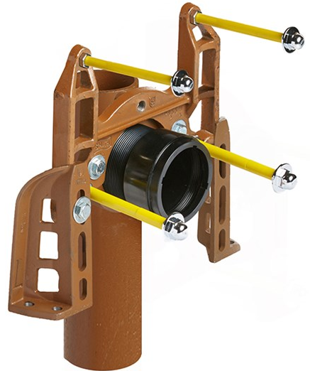
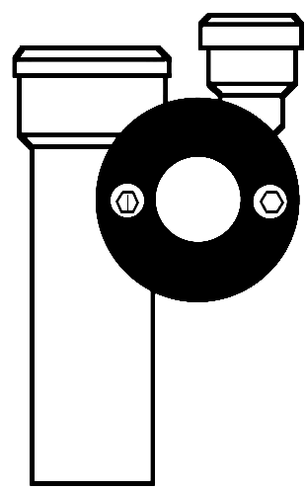
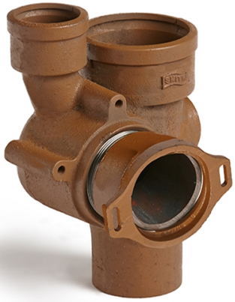
CONT’D
LIMITED CHASE SPACE?
Use Smith “compact” No. 0400 series.
BACK-TO-BACK BOWLS?
0440Y
Use Smith No. 0200D series.
FURRED WALL SPACE?
Use Smith “compact” No. 0400 or No. 0670-0680 stack fittings.
0675

Slide 17
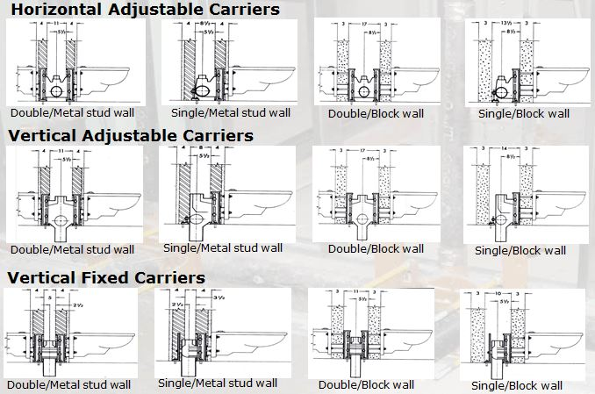
APPLICATIONS

Slide 18


CERTIFICATIONS
& LISTINGS
IAPMO Listed – File #1618
Conforms to ASME – A112.6.1M

Slide 19
SUMMARY
OFF-THE-FLOOR WATER CLOSET SUPPORTS:
SAVE TIME AND REDUCE INSTALLATION COSTS.
PROVIDE INSTALLATION VERSATILITY FOR BATTERY PREFABRICATION.
USE ADJUSTABLE HORIZONTAL AND VERTICAL FITTINGS TO FIT INSTALLATION REQUIREMENTS.
PROVIDE A WIDE RANGE OF APPLICATIONS.
REDUCE MAINTENANCE & CLEANING COSTS.
IMPROVE SANITARY CONDITIONS.

Slide 20
…QUESTIONS?

Slide 21
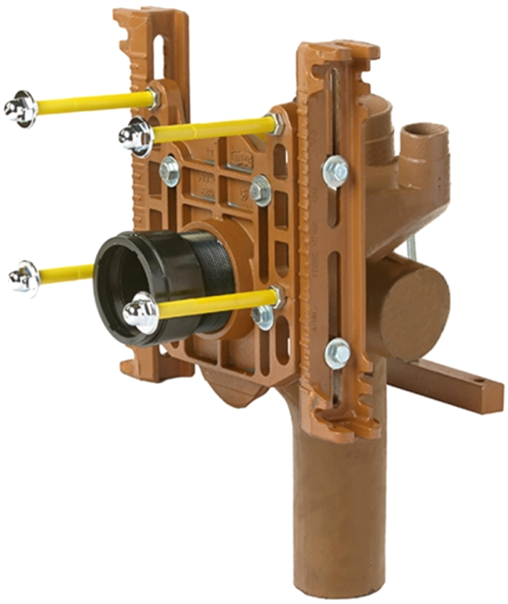
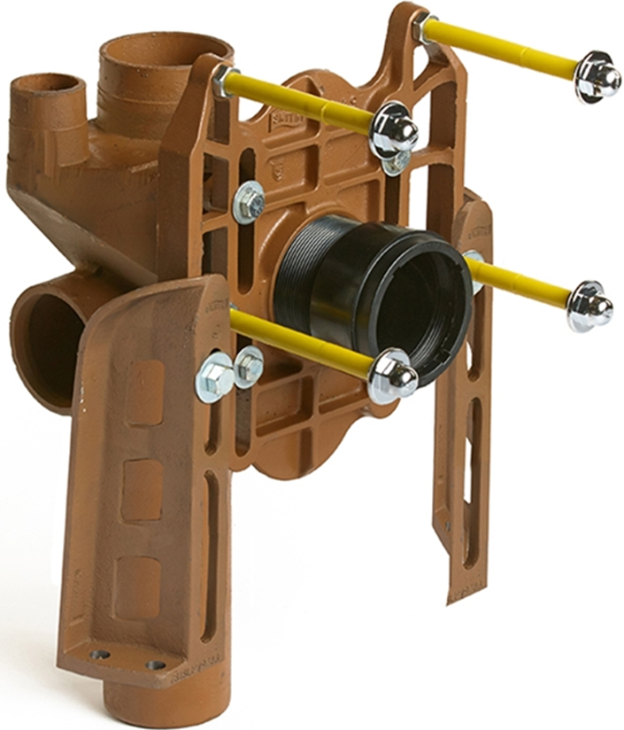
THANK
YOU!
0240Y-M54-XX
0185

