Slide 1
Future frontiers for Plumbing Design
Vacuum Plumbing Systems

Slide 2
Vacuum plumbing systems
What we are going to cover today –
About the technology -
A little history
Why it is relevant
How it works
Design considerations – how to employ it
A Plumbing Engineers Perspective -
Jeff Mortensen – Mosley Architects and Engineers
A Owners Perspective -
Jim Hudspath – Center for Medical Science

Slide 3
Vacuum plumbing systems
A little history –
The earliest recorded use of vacuum for sewage transportation was in
Europe in 1882
Modern, land based, vacuum drainage technology didn’t come into use until
the mid 20th Century
Improvements and specialization since then have divided the land based
use of the technology into two categories:
Sewerage systems – outside of the building structure
Plumbing systems – inside the building structure
The focus of this presentation is:
Vacuum Plumbing Systems within the building structure

Slide 4
Vacuum plumbing system Benefits
Design and Construction
Flexibility in design and layout of plumbing fixtures & equipment – overhead vs. in slab
Ability to “make-up” slope – less space required between floors
Provides a design solution for projects with architectural limitations or site conditions – ex. post tension slab; no mechanical chases, bad inverts
Reduced piping requirements – smaller sizes; less venting
Faster installation time

Slide 5
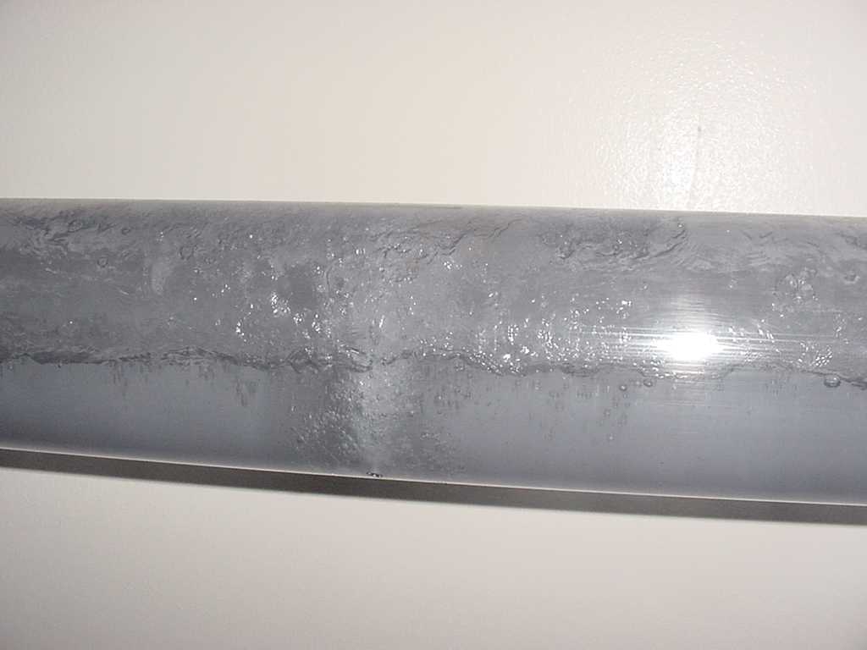
Vacuum plumbing system Benefits
Operations and Maintenance
Reduced water usage and sewage output (0.5 gpf vs. 1.28 or 1.6 gpf) = utility cost savings
Reduced blockages = reduced maintenance
Health and Environmental
Protection against leaking contaminants – no exfiltration
Cleaner environment - Vacuum WCs virtually eliminate the “plume” associated with gravity fixture flushing – reduces the spread of bacteria
Water savings – efficiently meets LEED and green standards

Slide 6
Vacuum plumbing systems
It’s relevance today is particularly meaningful considering:
If 1 gallon represents all water in the world
About 1 teaspoon represents all the fresh water we have for everything we need

Slide 7
Vacuum plumbing systems
By today’s standards, that makes vacuum drainage a high performance, water saving system:
Gravity
Plumbing
1.6 gpf
Low Flush
Gravity
Plumbing
1.28 gpf
Ultra Low Flush
Vacuum
Plumbing
0.4 gpf
[…queue the WTO counter…]

Slide 8
Vacuum plumbing systems
Definition for buildings….
A vacuum drainage system consists of components, materials, and hardware organized to provide a waste transportation system that does not depend entirely on gravity for the conveyance of waste products from their point of origin to their eventual disposal in a conventional gravity sewer system.

Slide 9
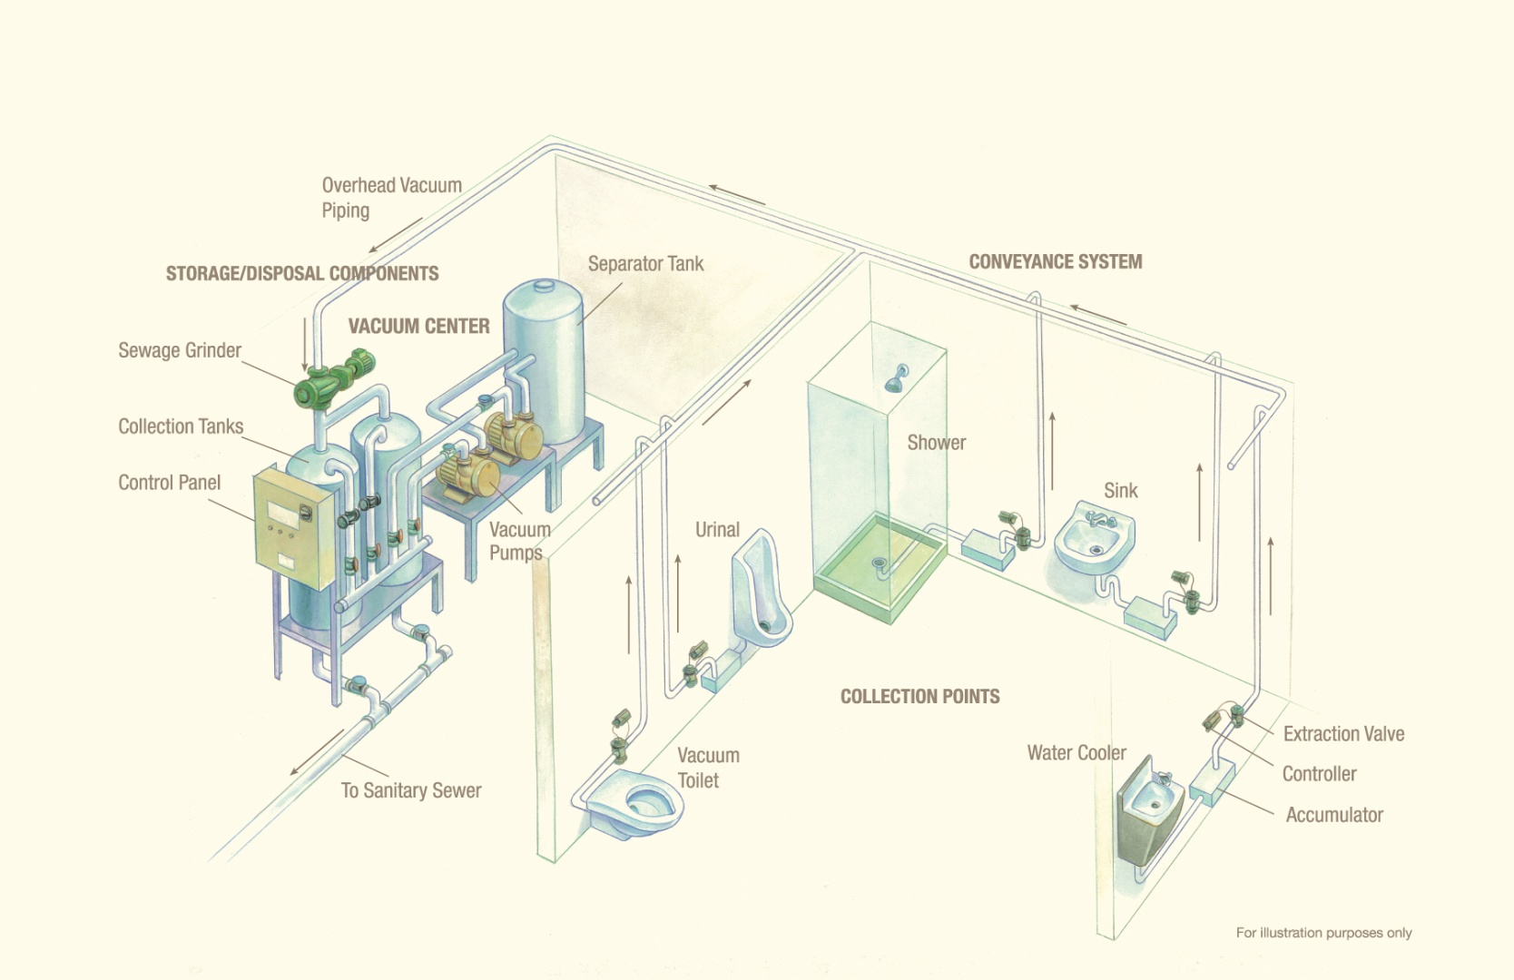
Vacuum plumbing systems
An example….

Slide 10
Vacuum plumbing systems
Principal of Operation
A vacuum drainage system employs the difference in pressure between a piping system maintained below atmospheric pressure, and atmospheric pressure surrounding a waste producing fixture, to assist in transporting the waste to the sewer system outside of the structure.
[…queue 01 Pressure Demo Movie…]

Slide 11
Vacuum plumbing systems
Vacuum Drainage Aids the Design Engineer
These pressure differences afford the engineer certain freedoms that are not available in a gravity-only system…
Waste from the fixture can be delivered to an overhead piping network, minimizing or eliminating floor penetrations.
The vacuum piping network eliminates the need for continuous slope from the fixture to the sewer main or stack.
Provides a reliable means to save millions of gallons of fresh water every year.

Slide 12
Vacuum plumbing systems
Vacuum Drainage is an integrated System
A vacuum drainage system is organized into three interactive and interdependent, subsystems…
The vacuum center
The vacuum piping network
The vacuum interface components

Slide 13
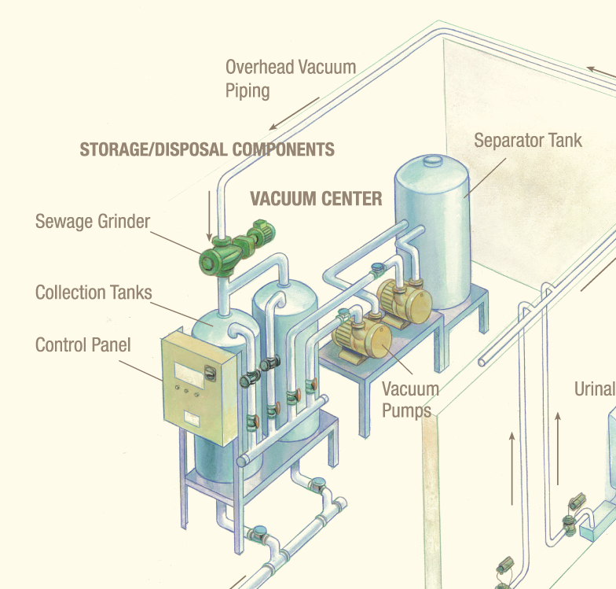
Vacuum plumbing system - components
The Vacuum Center
The Vacuum Center produces the
working vacuum pressures for the
piping network and vacuum interface
components, and includes tanks for the temporary storage of waste collected from the fixtures. It consists of:
Vacuum Pumps
Storage tanks
Controls to integrate their operation
In some instances may also include:
Discharge Pumps
Sewage grinders

Slide 14
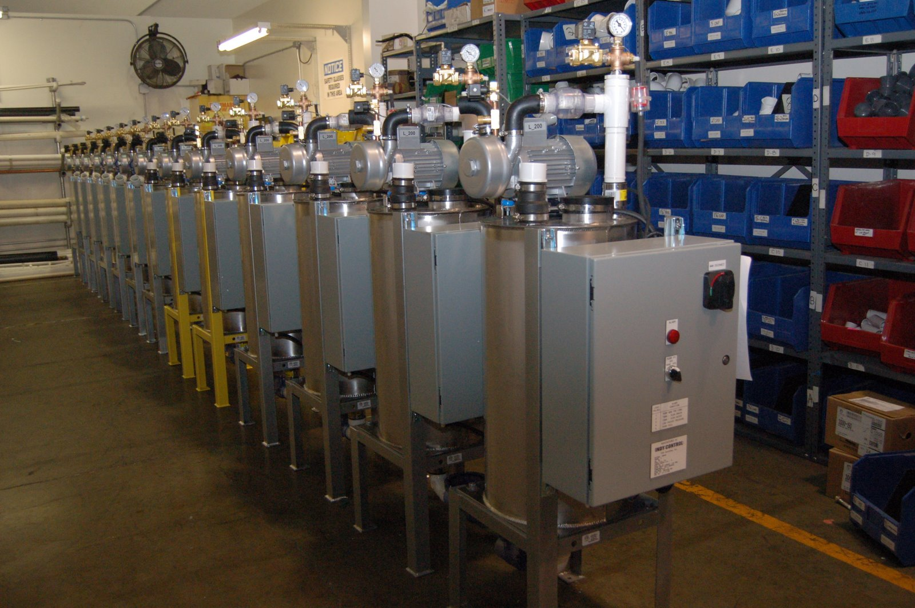
Vacuum plumbing systems
Vacuum Centers come in sizes to suit the application:

Slide 15
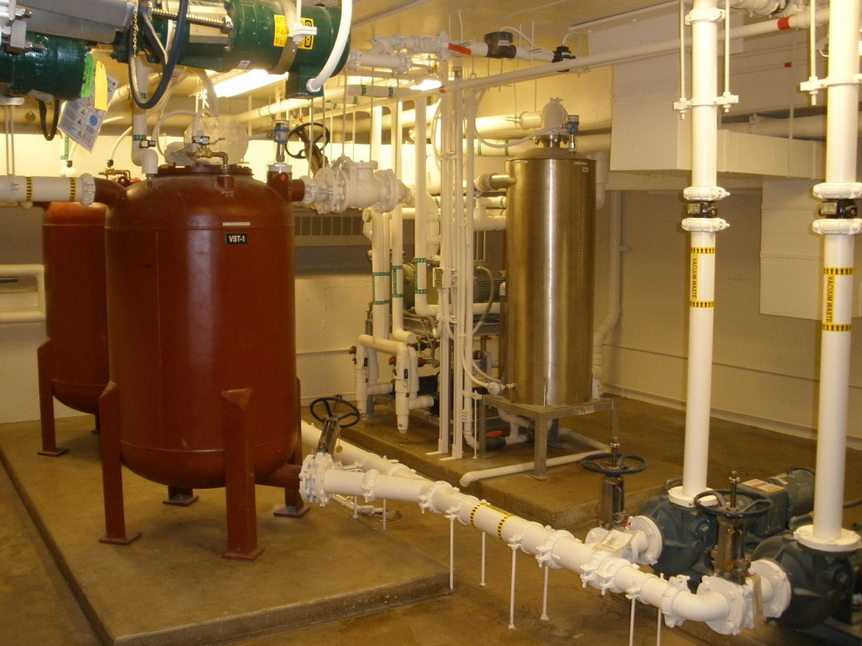
Vacuum plumbing systems
Vacuum Centers come in sizes to suit the application:

Slide 16
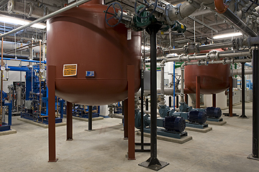
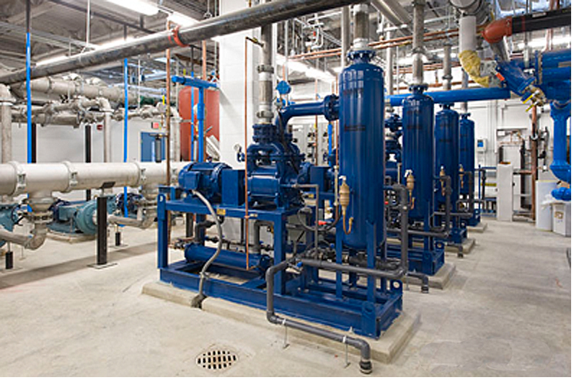
Vacuum plumbing systems
Vacuum Centers come in sizes to suit the application:

Slide 17
Vacuum plumbing systems
Vacuum Center Design Considerations – Vacuum Pumps
Vacuum pumps remove air introduced into the vacuum piping network as waste is evacuated from the fixtures and accumulators throughout the facility. Their sizing and quantity must take into account these factors:
The required nominal and minimum pressures for the system and Interface Valve operation – typically 16”Hg to 20”Hg
How much atmospheric air is introduced into the piping network when a vacuum interface valve is operated – manufacturer specific
The quantity of Interface Valves and the usage factor, or load profile, of the fixture use
The peak simultaneous and sustained Interface Valve activity. This will be an important factor in determining the optimum the Storage Tank and Vacuum Pump sizes

Slide 18
Vacuum plumbing systems
Vacuum Center Design Considerations – Vacuum Pumps
Degree of redundancy
For most applications duplex vacuum pumps, each sized for 75% - 100% of the peak load provides an acceptable level of redundancy.
For critical applications such as medical or correctional facilities, a minimum of three vacuum pumps, each sized for 50% of the peak load is recommended.
Effect of Storage Tank Volume on Vacuum Pump selection
Storage tank volume can be used to reduce pump sized with respect to the systems peak load

Slide 19
Vacuum plumbing systems
Vacuum Center Design Considerations – Storage Tanks
The Storage Tanks receive waste from the facility and, as the name implies, hold it for eventual discharge into the facility’s sewer main. Their sizing and configuration must take into account these factors:
A minimum of two tanks is recommended
Design and size must accommodate both the composition of the incoming waste streams as well as the volume
Redundancy and future expansion of the system should be considered
What volume the waste collection tanks will be with respect to the load profile – more volume can reduce vacuum pump sizing
Determine how the waste will be discharged from the tanks
Gravity drain
Pumped drain

Slide 20
Vacuum plumbing systems
Vacuum Center Design Considerations – Storage Tanks
Gravity drainage constraints:
Gravity drainage should be limited to those systems with Storage Tank volumes below 500 gallons each
Only one tank should be allowed to drain at a given time
When the off-line tank is draining, the tank(s) remaining on-line must have sufficient “free board” space (open space above the waste level) to absorb the anticipated inflow from the building until the drain cycle is complete
Include enough time in the drainage cycle to allow the vacuum pumps to recharge the vacuum pressure in the working pressure in the system
What volume the waste collection tanks will be with respect to the load profile – more volume can reduce vacuum pump sizing

Slide 21
Vacuum plumbing systems
Vacuum Center Design Considerations – Storage Tanks
Pumped Discharge constraints:
Pumped drainage is always required with the outlet of the Storage Tanks are below the invert of the sewer connection
Pumped drainage should be employed for those systems with Storage Tank volumes greater than 500 gallons each
Volumetric sizing follows the same general guidelines as a pump-down sump application. In general discharge pump capacity should be equal to the highest sustained inflow rate anticipated from the facility
The TDH (total dynamic head) of the discharge pumps must include the maximum negative pressure in the Storage Tanks – suction lift
The NPSHR (net positive suction head required) of the discharge pumps must be less than the NPSHA (net positive suction head available) in the Storage Tanks – be mindful of vapor pressures in the vessel

Slide 22
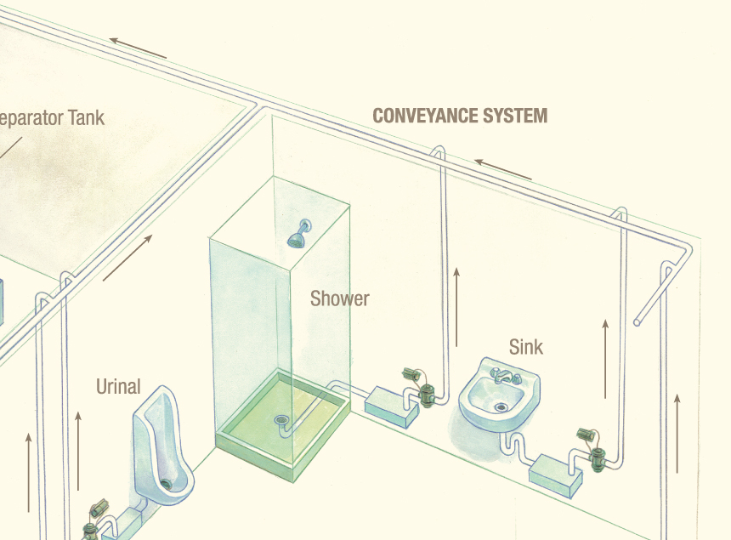
Vacuum plumbing systems
Vacuum Design Considerations – The Piping System
The piping network consists of horizontal and vertical main lines from the vacuum center to the building, horizontal branches off the main lines, and risers/droppers to connect the horizontal piping to the fixtures requiring drainage.

Slide 23
Vacuum plumbing systems
Vacuum Design Considerations – The Piping System
Selection of Proper Piping Material
Materials must be of smooth internal bore, non-porus, and suitable for vacuum pressures up to 29”Hg. PVC, CPVC, Schedule 10 Stainless Steel, and Type L or M Copper are good candidates.
Materials must suitable for the waste stream being processed
DWV pattern fittings are required for all directional changes

Slide 24
Vacuum plumbing systems
Vacuum Design Considerations – The Piping System
Piping Sizing, Layout, and Routing
Layout the system providing each toilet fixture and accumulator a connection with a vacuum interface valve, full port check valve, and isolation valve.
Typical piping connection from the toilet or accumulator to the main or branch is 1-1/2” to maintain proper velocities.
Vertical lift limitations – 22’ to 25’ without additional consultation with manufacturer
Offsets in vertical lift should be limited to 1, with a maximum offset of 12”
Enter overhead piping from above; offset no more than 45° from center

Slide 25
Vacuum plumbing systems
Vacuum Design Considerations – The Piping System
Piping Sizing, Layout, and Routing
Horizontal branch and main lines - use the Manning formula to keep pipe mains NO MORE than half full.
Horizontal mains and branches should be sloped at 2%. Without slope there is no energy to move the waste to the Storage Tanks except for the occasional opening of the Interface valve which only operates a few seconds during each evacuation cycle.
Good News! Vacuum drainage lets you recover slope so that the gradient does not have to be continuous between the fixture and vacuum center. The vacuum engineering term for this feature is “slope make-up”
Slope make-ups should be limited to 36” to total elevation difference.
[…queue 03 Slope Make-Up movie…]

Slide 26
Vacuum plumbing systems
Vacuum Design Considerations – The Interface Components
The vacuum interface components separate atmospheric pressure at the fixture from vacuum pressure in the piping network and allows waste to be removed from the fixture or its accumulator for delivery to the piping network. The major components are:
The vacuum interface valve
The vacuum interface valve controller
The vacuum specific fixture or accumulator

Slide 27
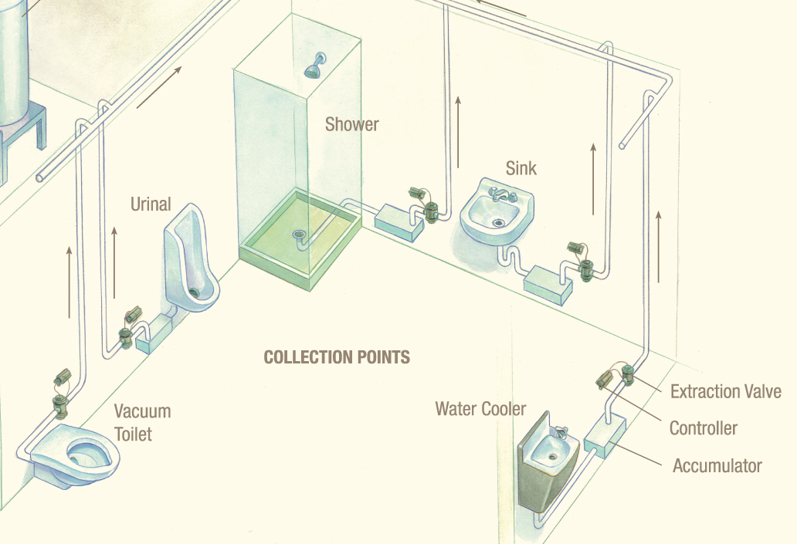
Vacuum plumbing systems
Vacuum Design Considerations – The Interface Components

Slide 28
Vacuum plumbing systems
Vacuum Design Considerations – The Interface Valve
The vacuum interface valve separates the two pressure regimes and is the workhorse of the vacuum drainage system. They must:
Provide a bubble tight interface between the fixture or its accumulator and the piping network
Provide a nearly unobstructed path for the waste stream during the evacuation cycle
Be normally closed for failsafe operation
[…queue 04 Interface Valves Movie; 05 Interface Valve Operation]

Slide 29
Vacuum plumbing systems
Vacuum Design Considerations – The Interface Valve Controller
The vacuum Interface Valve Controller determines when the Interface Valve must be opened and time the Valve opening appropriately to insure that the waste is completely removed from the fixture or accumulator and delivered to the piping network.

Slide 30
Vacuum plumbing systems
Vacuum Design Considerations – The Interface Valve Controller
Pneumatically powered Interface Valve Controllers:
Pneumatically powered units are the simplest and least expensive solution to regulating the waste removal process. They get their operating energy from the vacuum pressure in the piping network and require no separate power source.
Offsetting the low cost benefit, pneumatically powered controllers have limited accuracy, repeatability, control features, and functions.

Slide 31
Vacuum plumbing systems
Vacuum Design Considerations – The Interface Valve Controller
Electronic Interface Valve Controllers:
Electronic Valve Controllers offer a wide range of control functions and features not available with pneumatic controls:
Improved valve timing accuracy and repeatability
Potential for valve time to be optimized for maximum system operating efficiency
Ability to be networked for remote monitoring and diagnostics

Slide 32
Vacuum plumbing systems
Vacuum Design Considerations – The Interface Valve Controller
Interface Valve Controllers are typically either pneumatically or electronically powered.
Offsetting the benefits of the Electronic Valve Controllers, is a slightly higher cost and the possibility of having to involve a separate trade for their installation.

Slide 33
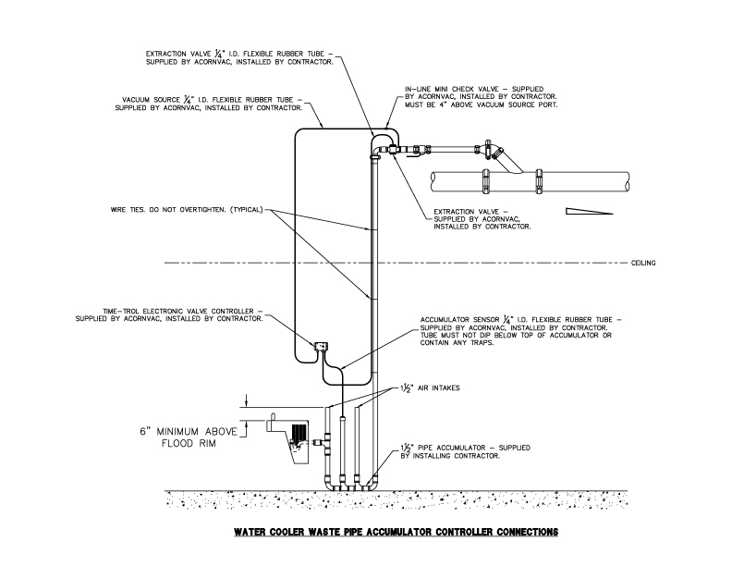
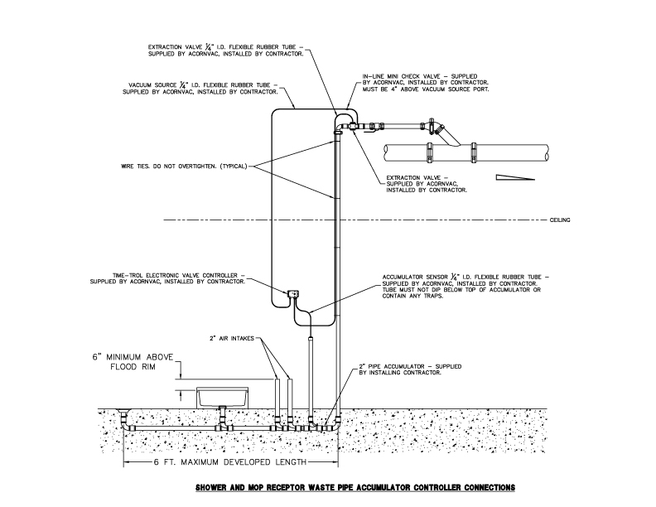
Vacuum plumbing systems
Vacuum Design Considerations – The Fixtures
The Water Closet is the only purpose-built vacuum fixture. This special device is what allows the remarkable water savings to be achieved using only 0.4 to 0.5 gallons per flush.
All other fixtures are standard gravity types and discharge their waste into temporary containment vessels (accumulators) until a sufficient amount has collected for it to be efficiently transferred to the piping network via the Interface Valve.
[…queue 06 Lavy Pipe Accumulator Example + 07 Sensor]

Slide 34
Vacuum plumbing systems
Vacuum Design Considerations – The Accumulator
Accumulator sizing is critical to the operating efficiency of the system. The volume selected must take into account:
The inflow volume from the fixture
The minimum discharge rate from the fixture via the Interface Valve – manufacturer specific
The air volume introduced into the piping network during the discharge event as this must be accommodated by the vacuum pumps – manufacturer specific

Slide 35
Vacuum plumbing systems
….let’s see the whole thing in action
Video presentation of a typical toilet flush and lavy drain.
[…queue 02 Toilet Flush + 08 Four Square]

Slide 36
Vacuum plumbing systems
In conclusion, designing a vacuum drainage system is about the things you already know….
Pumps
Tanks
Pipes
Water
Valves
Waste
…nothing more
[…segue to Jeff Mortensen …]

Slide 37
A designers perspective

Slide 38
Vacuum plumbing systems
Amherst Adult Detention Facility – Lynchburg, VA
Facility:
380 Bed Regional Jail with Minimum to Maximum Security Levels and Work Release Dormitories.
Estimated annual cost for water and sewer for traditional waste system - $105,450 vs. annual cost for water and sewer with VPS of $47,290. The result - more than $47,000 savings per year allowed a payback period of less than 5 years.
The life cycle cost analysis was not performed because the owner saw the system as what it is, pumps and pipe and tanks. Nothing more than they deal with on a regular day-to-day operation.
The system will save just under 3,000,000 gallons of water per year for the life of the facility.

Slide 39
Vacuum plumbing systems
Designer’s Considerations:
Client education - systems are not “new” technology
Proven technology in transportation with significant evolution for land based use over last 20 years.
Many of the earlier problematic issues have been overcome.
More than one US manufacturer – all with continued commitment to land based use.

Slide 40
Vacuum plumbing systems
Designers Considerations :
Client education – best systems are those which are properly designed, installed and maintained.
Addressing owners concerns:
Cost payback
Yearly operational and maintenance cost
Maintenance requirements different than a traditional gravity system
Potential advantages in “sole source” manufacturer.
Impact on design, specification and procurement.

Slide 41
Vacuum plumbing systems
Designer’s Considerations:
Plumbing load estimation – lack of prescriptive guidelines; “engineered” system
International Plumbing Code (IPC) allows and addresses these
systems in Section 105.4 – Alternative Engineered Design
Manufacturer provides guidelines

Slide 42
Vacuum plumbing systems
Recommendations for handling vacuum plumbing project design:
Preliminary Design Phase
Review the applicable local codes to determine requirements.
Consult with the local code official to ensure the system will be accepted as an engineered alternative.
Evaluate the type of fixtures and drainage loads for the system – water closets, floor and shower drains, safety equipment, fire protection test equipment and sprinklers, grease waste, high temperature waste, chemical waste – all sources.
Some may need to be excluded due to incompatibility with the manufacturer’s system.

Slide 43
Vacuum plumbing systems
Preliminary Design Phase
Consider including the local code authority in the preliminary evaluation process. Ideas:
Provide a preliminary submittal for the code authority including
architectural floor plans, code analysis, occupancy profile, site plan,
manufacturer product literature addressing vacuum components,
fixtures and operational overview.
Set up a meeting with the code authority to address any potential
questions regarding what is connected to the system and the method
of calculations.

Slide 44
Vacuum plumbing systems
Schematic Design Phase
Develop minimum service space requirements for the system components during schematic design, and coordinate with the architect so service space can be incorporated.
Consider plumbing fixture chases where vacuum interface valves, isolation valves, valve controllers and accumulators will be located (typically close to the fixture). Don’t forget to consider lighting for these areas if required for maintenance is required.

Slide 45
Vacuum plumbing systems
Basics of Pipe sizing and Design
Select the proper piping material - – typically PVC, CPVC, stainless steel and DVW copper.
Layout system providing each toilet fixture and accumulator a connection with a vacuum interface valve, full port check valve, and isolation valve. Typical piping connection from the toilet or accumulator is 1-1/2” to maintain proper velocities.
Horizontal branch and main lines - use the Manning formula to keep pipe mains half full. Consider:
Probability of simultaneous use of fixtures; fire protection flows
Be conservative…use care not to overburden the system with unrealistic flow occurrences.

Slide 46
Vacuum plumbing systems
Basics of Pipe sizing and Design
Include pipe gradient, long radius-type DWV fittings and cleanouts.
Include specification for pipe installation
Piping must be capable of being reamed to be free of burrs
slag and depressions from roll-cutting (if used)
Pipe joints must be capable of holding full vacuum pressure of 29” Hg.
Entire system should pass vacuum pressure test with minimum leak rate of .10” hg/minute.
Consider the possibility of developing additional piping details that will thoroughly illustrate the installation requirements
Possible “double line” or isometric piping plans - BIM
Elevation views of vacuum equipment in any area where layout may not be clear to avoid contractor installation issues
Use system manufacturer for review and comment.

Slide 47
Vacuum plumbing systems
Basics of Vacuum Center Equipment Selection
Calculate the air flow requirements of the system to select appropriate capacity and quantity of vacuum pumps. Consult with equipment manufacturers for vacuum pump capacities.
Important considerations:
Redundancy
Potential for future expansion of the system
Peak load profile - impact
Sanitary sewer system limitations – impact on waste collection tank and discharge pump sizing
Any unique operational requirements of the facility

Slide 48
Vacuum plumbing systems
Recommendations for bid process and contract award:
Consider providing an advance project review with potential bidders to eliminate any concerns about unknown requirements. Remember to:
Include a complete overview of the system design
Address installation requirements
Describe similarities of vacuum to standard DWV systems and items that are unique.
Consider pre-qualification requirements for potential bidders on projects of significant size and scope. Ex. MEP ability for ease of coordination; experienced on projects of a similar or larger scope; bondable for the size of the project

Slide 49
An owners case study & perspective

Slide 50

Case study – bsl-3 laboratory
Center for Medical Science
Albany, NY
8,000 gsf
3rd floor of fully occupied building
BSL-2 labs, lab support, and administrative space
No available surge space

Slide 51
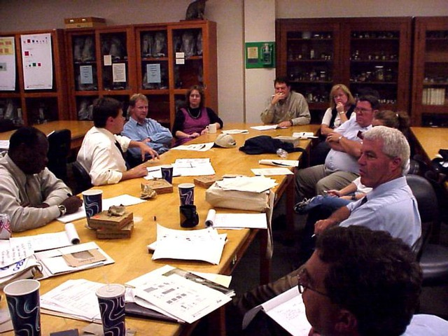
Case study – bsl-3 laboratory
Primary driver:
Occupancy date / aggressive
90-day construction schedule
Owner took risk: cost plus/ open book
High degree of trust among Owner, A/E, and CM
Very fast resolution of issues
On-line submittals, RFI’s, etc.

Slide 52
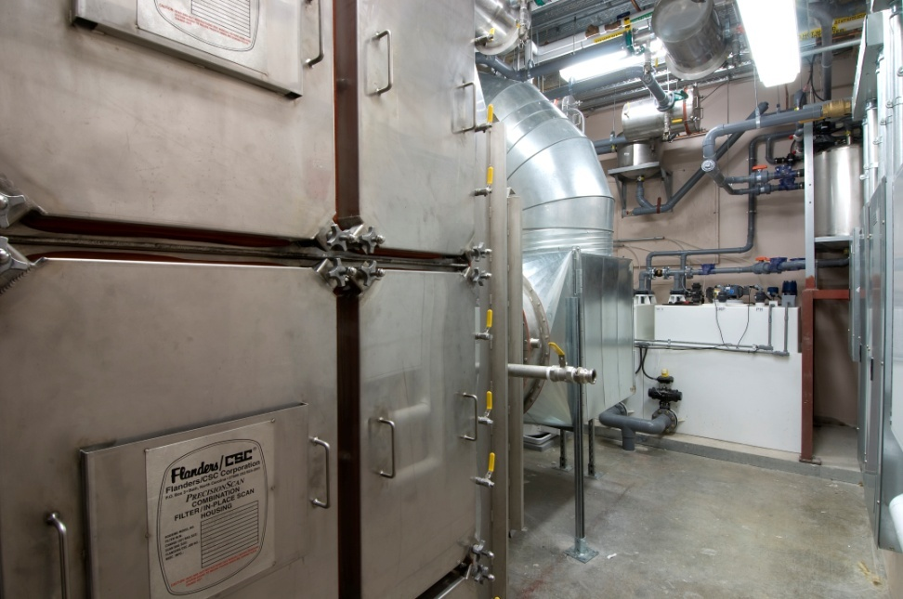
Case study – bsl-3 laboratory
Overriding strategy - Provide decontamination of sanitary
waste and exhaust air within boundaries of BSL-3 space to
avoid disruption to operations in surrounding areas
Vacuum sanitary waste system
Decontamination system
HEPA filtration of exhaust air
Necessitated creating a mechanical equipment room within the BSL-3 space

Slide 53
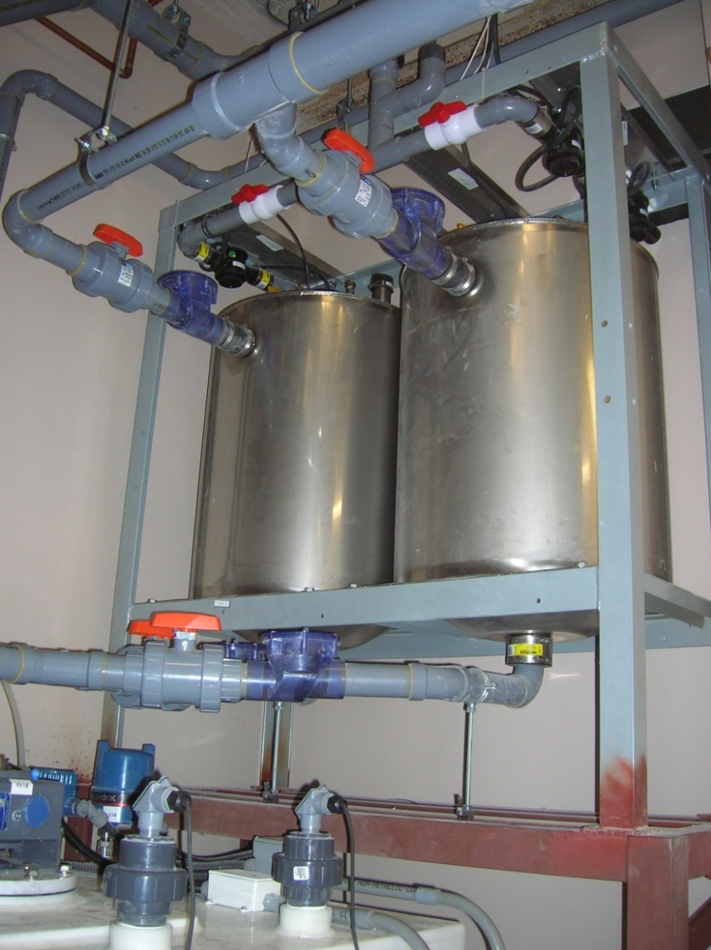
Case study – bsl-3 laboratory
Idea generated through casual conversation
Entire system located within the boundaries of BSL-3 space except vacuum pumps are in penthouse

Slide 54
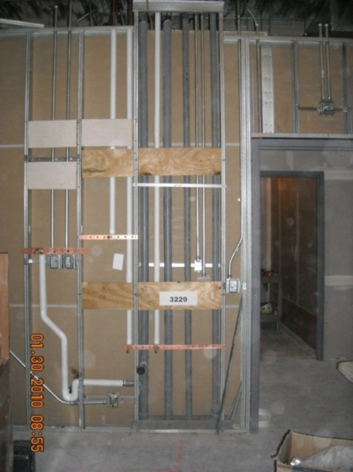
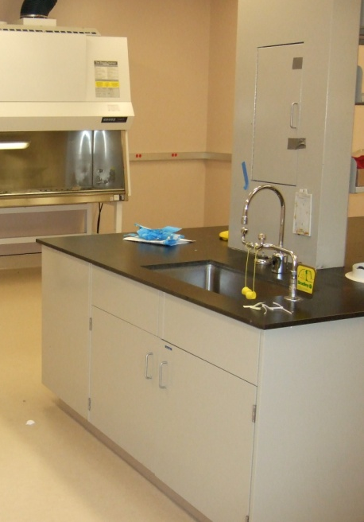
Case study – bsl-3 laboratory
VPS is providing drainage for sinks and
decontamination showers.

Slide 55
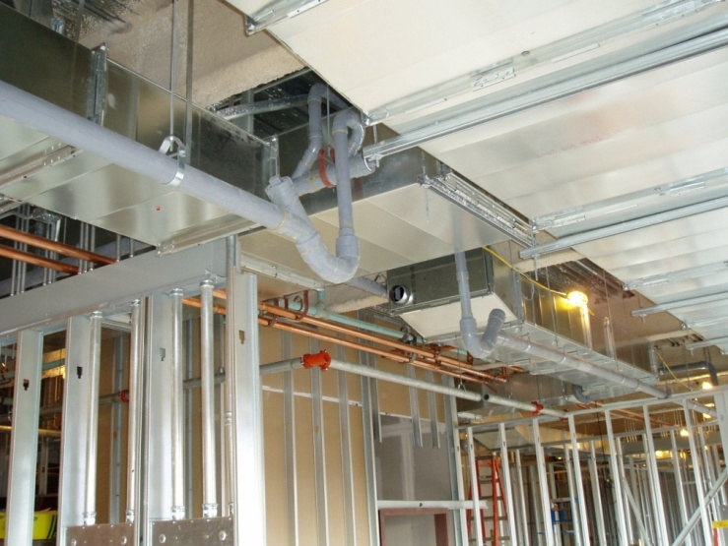
Case study – bsl-3 laboratory

Slide 56
Case study – bsl-3 laboratory
Vacuum waste piping routes to vacuum waste collection tanks, located 8 feet above the floor

Slide 57
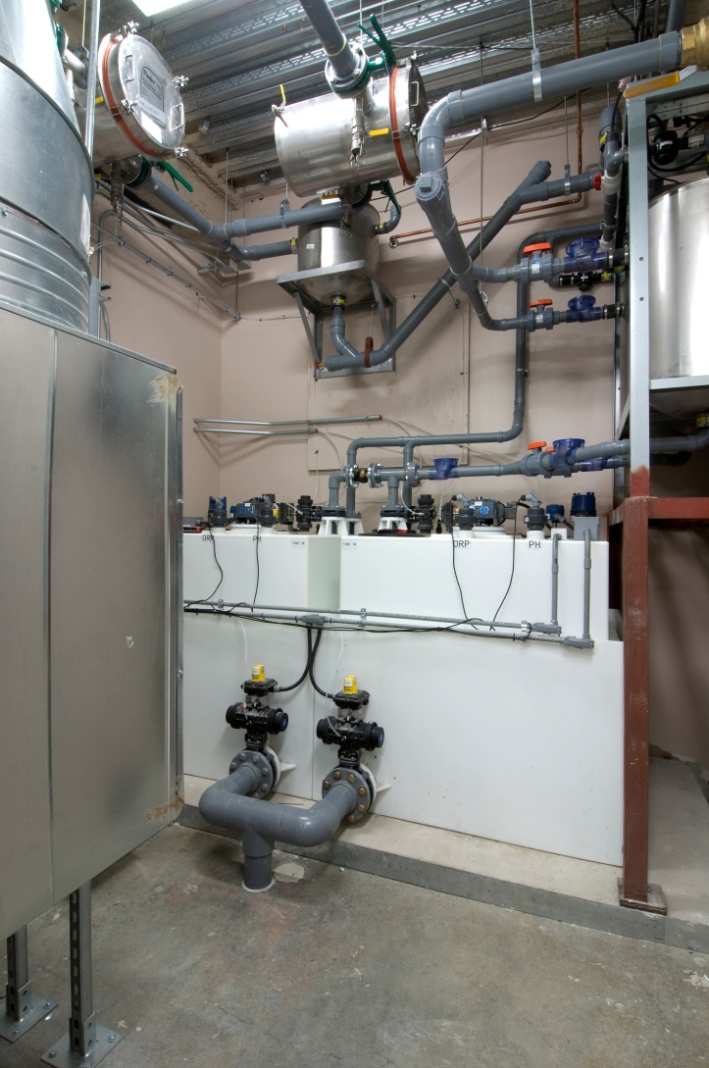
Case study – bsl-3 laboratory
Vacuum waste collection tanks discharge into waste water decontamination tanks below them
Collection and decontamination tanks are sized according to the maximum waste water flow rate
Collection and decontamination tanks operate lead-lag: one fills while the other dumps

Slide 58
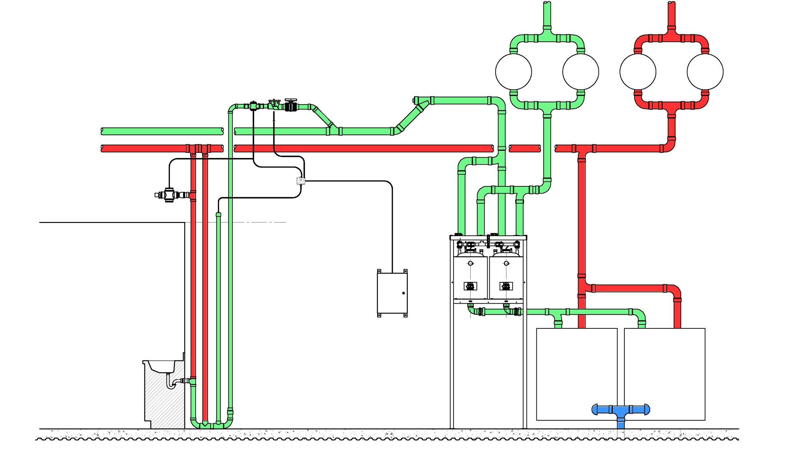
Vacuum Waste System Schematic
TO VAC
PUMP
HEPA
FILTER
HEPA
FILTER
HEPA
FILTER
HEPA
FILTER
SANITARY WASTE FROM SINKS
TO VENT
VENT FROM
SINKS
CEILING
ZONE CONTROL PANEL
COLLECTION
TANKS
HAND SINK
WASTE DECONTAMINATION TANKS
ACCUMULATOR
DRAIN TO SANITARY
WASTE LINE

Slide 59
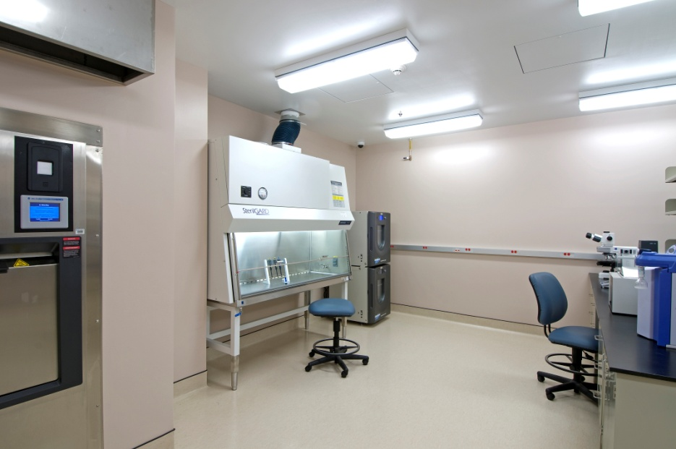
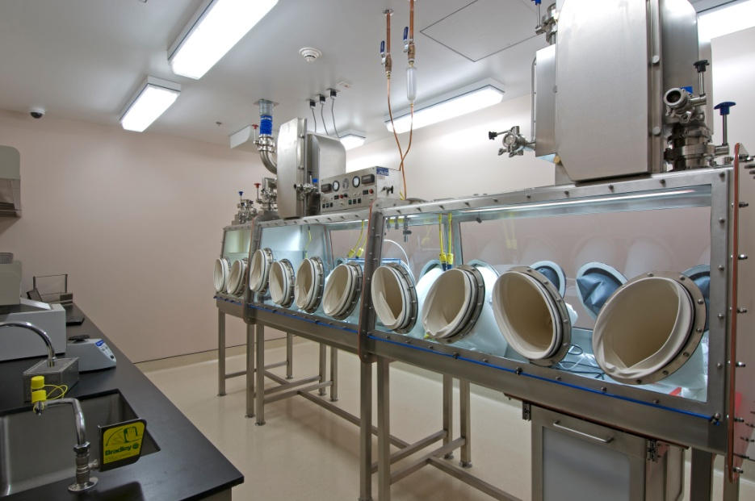
Case study – bsl-3 lab
CDC licensing went very smoothly
USDA permits to transport select agents have been granted
Lab has gone hot and is producing revenues!

Slide 60
Vacuum plumbing systems
?

